Slide 1
Digital Transformation and BMs:
What is new?
Prof. dr. H. Bouwman
Delft University of Technology, The Netherlands
Åbo Akademi, Turku, Finland
Bled Conference, Bled , 2018

Slide 2
Digital transformation
Where does ICT start and digital transformation end?
Digital transformation new label used for the last ten years
  Associated technologies: social, mobile, analytics, cloud induced change, Ind 4.0, IoT, blockchain and whatever smart
  Radicalness, disruptive changes related to technology, instead of gradual changes
  Increasing connectivity, pervasiveness ,computing power, on-going digitalization
  Affecting behaviour of individuals, organizations, society

Slide 3
But how related to strategy, business models, processes?
Based on strategic considerations,
affecting BMs,
that will lead to technical implementation (architectures, platforms),
in combination with –organization focussed -change management, and
in a dynamic way affecting internal processes and external organizational networks for resource acquisition (eco-systems)
leading to changing revenue models, sharing of investments, pricing models, but most importantly value capturing might be realized in unexpected spots
based on continues, dynamic, iteration, changes and adaptations

Slide 4
BM (research) “dilemma’s”
Design or analytical
Reductionist or focus on inherent complexity
Economic value or value sensitive designs
  Decision on value trade offs throughout the life cycle of a BM beyond economic one
Business or product/service unit of analysis
  Multilevel networked BMs: bottom up – top down
Static or dynamic BMs
Technology driven or technology enabled
Business architectural (large firms) or platform based (agile and start ups)
Focus on either large corporates /start ups (unicorns) or on traditional SMEs

Slide 5
Concepts and theories
Business strategy
Business
model
Business
Architecture
Strategy design: SWOT, PESTEL
(Selznick,1957)
  Strategic Planning School :Business Plan
  (Ansoff, 1965)
Strategic positioning: Competitive Advantage,
5forces and Activity system (Porter, 1980)
Resource Based View (Barney) and
Dependency (Pfeffer & Salancik, 1978)
Emerging and contingency approaches
CANVAS (Osterwalder & Pigneur, 2004, 2010)
STOF (Bouwman et al, 2002, 2008)
CSOFT (Heikkila et al 2010)
STOF-VIP (Bouwman et al 2013)
VISOR ((Omar El Sawy, 2012)
BM component (IBM, 2005)
BM Cube (Lindgren)
………..
BM meta-model
BM tooling
Quick Scan
Stress testing
Roadmaps
VIP
Business Architecture
Enterprise Architecture
Business Processes
Process tooling
BPM
Aris
Architecture thinking
Archimate
Togaf
et cetera
Metrics

Slide 6
But what happens in practice?

Slide 7
Does Business model innovation matter?
SMEs the primary economic and innovative force and job creators
...49% of SME in EU involved with BMI
...19% of them use tool(s)
...they are performing above average in terms of profitability and growth
Source: ENVISION Research 2015-2017

Slide 8
Envision research project
76% introduced new services
83% introduced new ways of organizing relations with customers
62% focused on complete new market segments
78% started working with new business partners
78% introduced new products
64% shared new responsibilities with new business partner
65% introduced new distribution channels
88% of product/service offering is enabled by ICT
73% introduced new ways to transact with customers
89% introduced new ways to reduce variable costs
89% introduced new ways to reduce fixed costs
71% introduced new pricing mechanisms
80% created new revenue streams
91% introduced new ways to be profitable

Slide 9
structural model
Innovation activity
STRUCTURAL OVERALL MODEL 2016 + 2017 (unique observations, N = 1240)
Innovativeness
Internal drivers
.46 (3.47)***
Average number of innovations
Strategy
.24 (1.76)*
BM innovation practices and governance
.65 (14.95)***
R²=.42
BM Experimentation
.69 (15.78)***
BM Practices
-.12 (2.01)**
.21 (3.77)***
Competitive intensity
.26 (4.58)***
R²=.45
R²=.47
External drivers
Overall performance
Technology turbulence
.08 (1.48)
Performance
R²=.18
Adjustment fit
Chi-Square=796.87 df=195 RMSEA=.05
NFI=.96 CFI=.97 SRMR=.07 GFI=.93
Significant relationship (t-values)
Non Significant relationship (t-values)

Slide 10
However Digital Transformation in SMEs is about
basic use of IT, Social Media, and Big Data (BDA)
0.26 (4.83) ***
R² = 20%)
0.44 (11.8) ***
0.23 (4.57) ***
0.52 (17.66) ***
0.24 (5.4) ***
R² = 15%)
0.21 (4.7) ***
0.17 (3.6) ***

Slide 11
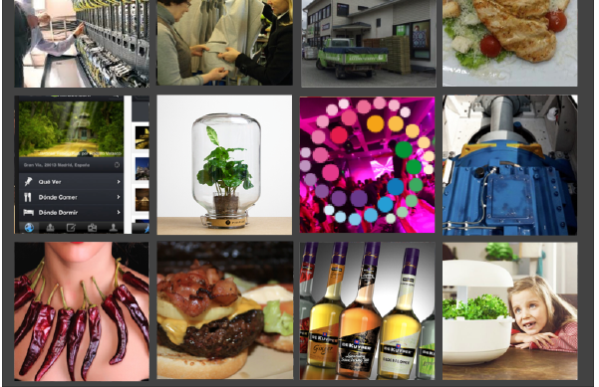
we do case studies...

Slide 12
Type of case studies
Analytical cases about 120
ADR cases (25 out of the 120)
  Cases focussed on developing or improving tools
  Cases focussed on how tools are used in practice
    Envision researchers involved
    By case owner
  Cases focussed on how tools are used via platform
Examples tool related ADR cases
Stress testing
  Microcap case, Insurance case… DESIGN of TOOL
    Zo Dichtbij, HCI, Fairshare…. IN f2f sessions, with
    Educational platform, Saas provider, IT for Horticulture, Himalayan salt----without Envision researchers
  Alpatron, Routigo, West IT … TOOL usage via platform
Road mapping
  Internationalization cases: Be Tribes; From ISP to Smart Living SP
    Audio trip, Branded 3, BurgerZ, Roadapps
    Jetflite
  M-Industries
VIP (eco-system) in combination with UML
  string of cases to develop concept, visualization
  Medicine dispenser, M-health application, IoT case

Slide 13
BM Change pattern for Growth
[Find new
channels]
[Select
partners]
+ Market Entry/Expansion
[Improve the
offering]
[Know my
customers]
[Attract
customers]
[Explore the
market]
+ Market analysis
BM components:
Customer
Relationship
Customer
Segments
Value
& Services
Key Partners
Channels

Slide 14
so, we do qualitative and quantitative analyses for
Back ground characteristics
Micro, small and medium sized enterprises
Female entrepreneurs
Family businesses
Topic related
Internationalization
Usage of social media, big data and so on
IT implementation and usage
Platform design
Data-driven BMs
Social aspects of BMI implementation
Tool related
Stress testing
Road-mapping
Eco-systems and VIP
Metrics
BM and EA making use of UML

Slide 15
We express BMs in UML

Slide 16
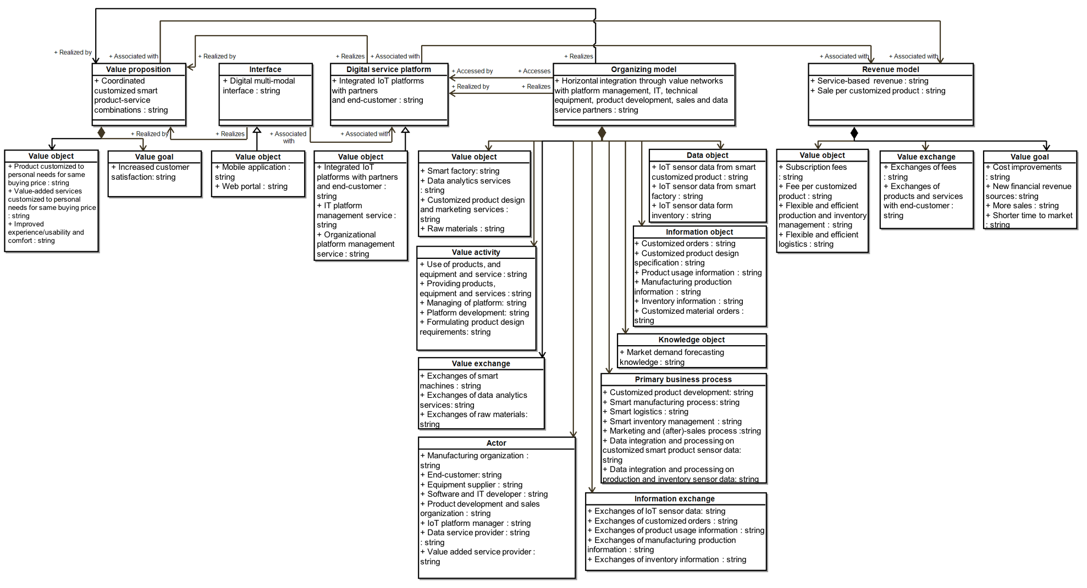
In order to connect BM to EA

Slide 17

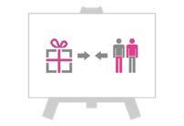






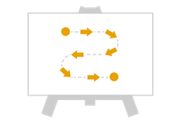


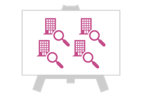


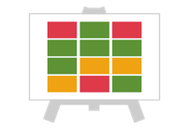

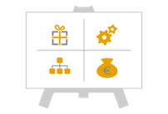
we create (and use) tools...

Slide 18
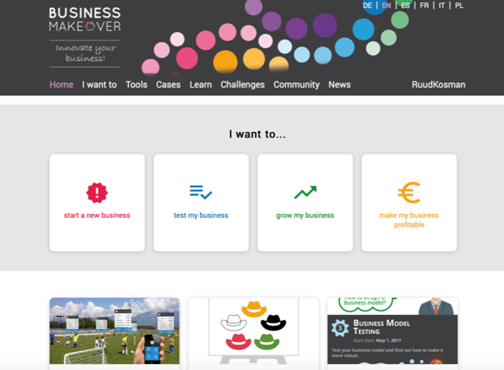
to answer I want to questions

Slide 19
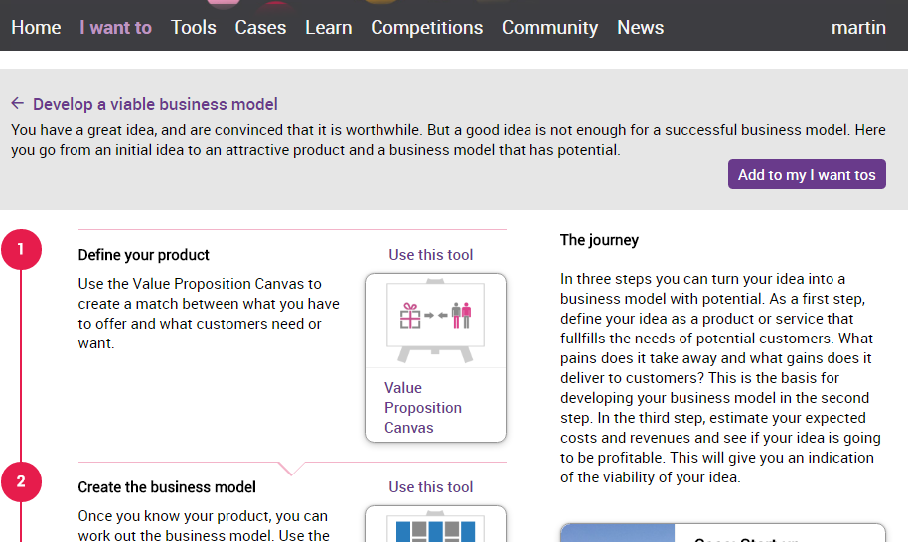
Tool paths
Notes:
LIVE DEMO VAN PLATFORM BUSINESSMAKEOVER.EU
Verschillende stappen = tools
Beschrijving van wat je gaat doen = journey
Wat heeft het anderen gebracht = case

Slide 20
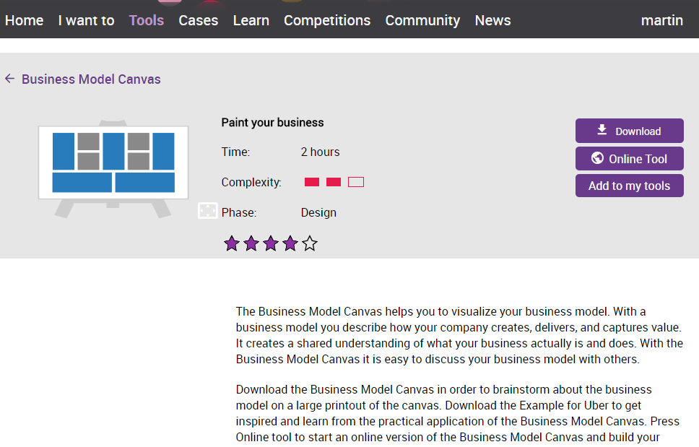
Tool detail page

Slide 21
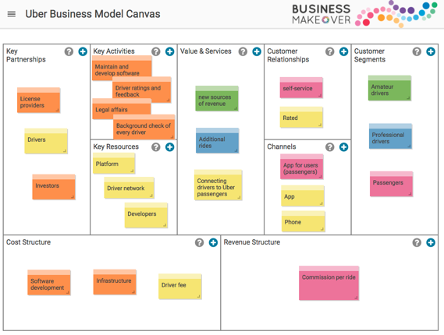
Interactive online tool
Notes:
LIVE DEMO VAN PLATFORM BUSINESSMAKEOVER.EU
Korte beschrijving
Details van de tools → tijd, complexiteit, phase, reviews
Acties → download, online tool, voorbeeld, eigen werkgebied
How to use
case

Slide 22
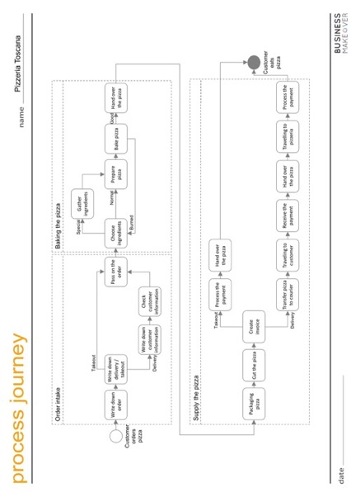
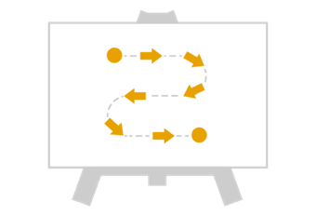

Process Journey
phase: design
The Process Journey helps you to draw your workflow or business processes as a series of activities.

Slide 23
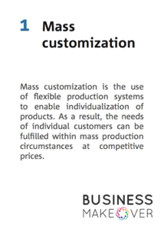
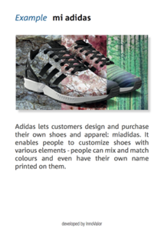
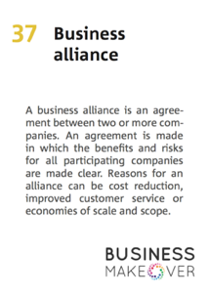

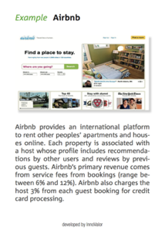
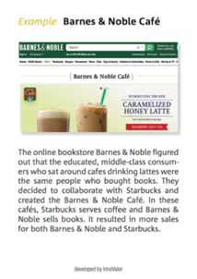
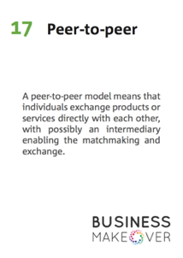
Business Model Cards
phase: design
The Business Model Cards help you to create new ideas when drawing up a business model.

Slide 24
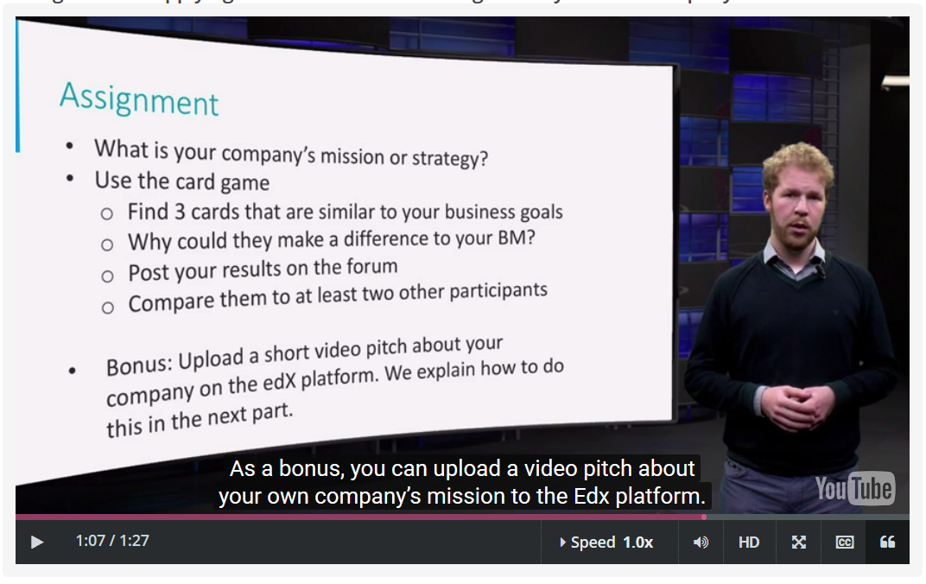
As also used in our five online courses...

Slide 25
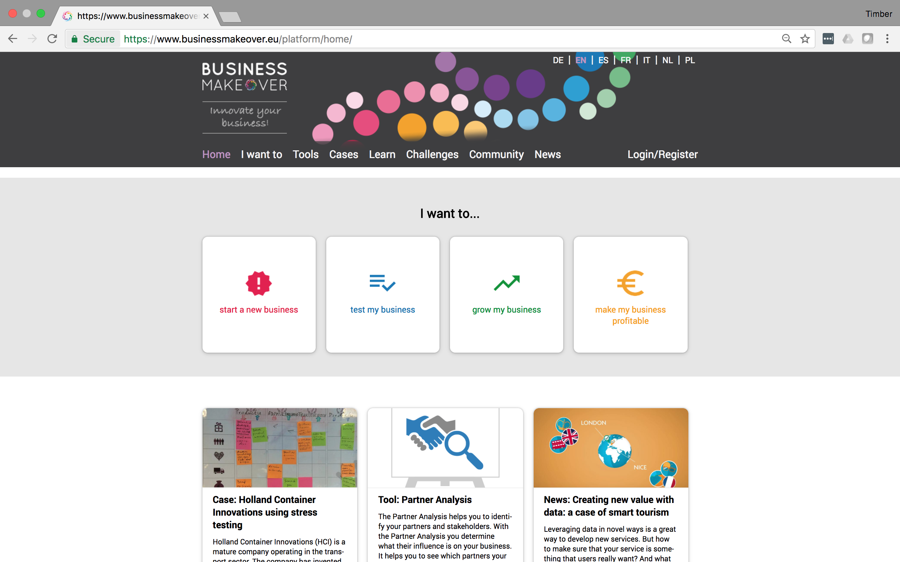
and it is all available for free, in multiple languages @... Businessmakeover.eu

Slide 26
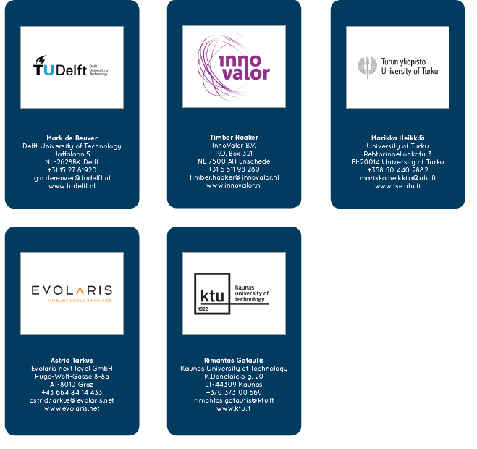
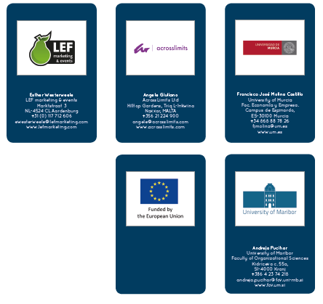
Made possible by

Slide 27





Thanks for your attention
Harry Bouwman
w.a.g.a.bouwman@tudelft.nl
+31 6 81 41 69 01
@innovateBM
Businessmakeover.eu

