Slide 1


Digital Transformatin: Meeting the Challenges
TRANSITION TO A SUSTAINABLE ECONOMY
CRITICAL ROLE OF THE DIGITAL TRANSFORMATION
31st Bled eConference
17-20th June 2018
JANEZ POTOČNIK
Co-chair UNEP International Resource Panel (IRP)
Partner SYSTEMIQ

Slide 2
OUR WORLD …

Slide 3
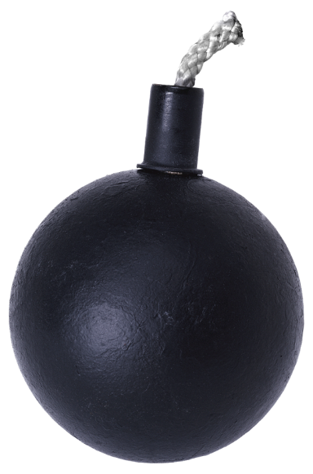

20th CENTURY
THE GREAT ACCELERATION
Growth of population by a factor 3.7
Annual extraction of construction materials grew by a factor of 34, ores and minerals by a factor of 27, fossil fuels by a factor of 12, biomass by a factor of 3.6
Total material extraction grew by a factor of 8
GHG emissions grew by a factor of 13

Slide 4
Signed by over 15000 scientists from 184 Countries on 13.November 2017
„Humanity has failed to make sufficient progress in generally solving these foreseen environmental challenges, and alarmingly, most of them are getting worse.“

Slide 5
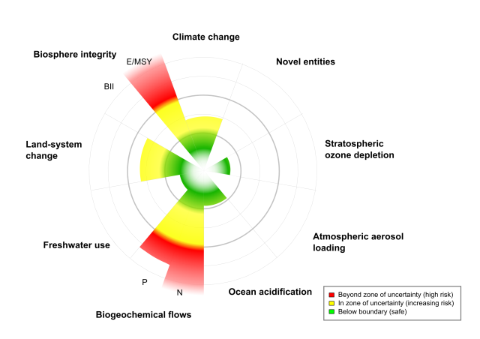
“PLANETARY BOUNDARIES”
Source: Steffen et al. 2015

Slide 6

THE TASTE OF 21ST CENTURY
POPULATION
Population growth (2050 – 9.7 billion)
Per capita consumption growth (up to 3 billion consumers moving from low to middle class consumption till 2030)

Slide 7
THE TASTE OF 21ST CENTURY
POWERTY AND SOCIAL INEQUALITY
Oxfam Report: 8 people own the same as the poorest half of the world and the richest 1% is more wealthy than the rest of the world)
Nearly 800 million people are hungry, over 2 billion suffer from micronutrient deficiencies … while over 2 billion people are obese
We throw away one third of the food we produce

Slide 8
THE TASTE OF 21ST CENTURY
ENVIRONMENT I
There is increasing evidence of the climate change threat
60% of ecosystems already degraded or used unsustainably
Disappearing biodiversity - the rate of number of species that become extinct is 1000 to 10000 times higher due to the presence of humans
More than 85 % of the world's fisheries are at, or beyond, their biological limits

Slide 9
THE TASTE OF 21ST CENTURY
ENVIRONMENT II
33% of soils is moderately to highly degraded due to erosion, nutrient depletion, acidification, salinization, compaction and chemical pollution
467 000 premature deaths yearly in EU due to air pollution (7 millions globally)
A million of plastic bottles are bought every minute. In 2015 9% of plastic was recycled, 12% incinerated, 79% accumulated in landfills or the environment

Slide 10
THE TASTE OF 21ST CENTURY
URBANISATION
Globally, an area of the size of the UK has been converted to buildings since 1990 (OECD GG Indicators 2017)
More than 50% of urban fabric expected to exist by 2050 still needs to be constructed
In the three years period (2011-2013), China has used more cement than the USA during the entire 20th century

Slide 11
THE TASTE OF 21ST CENTURY
ROBOTISATION
Nearly half of all the work we do, will be able to be automated by the year 2055 (McKinsey Global Institute)

Slide 12
THE TASTE OF 21ST CENTURY
DIGITAL TRANSFORMATION
In 1997, Deepblue beat Gary Kasparov – world Chess champion - using an algorithm conceived in the 1950s and lots of human data.
In 2017, AlphaGo beat Ke Jie - world Go champion – itself discovering the principles of the game and how to play it (era of artificial intelligence)

Slide 13
THE TASTE OF 21ST CENTURY
GLOBALISATION
For the first time in a human history we face the emergence of a single, tightly coupled human social-ecological system of planetary scope. We are more interconnected and interdependent than ever.
Our individual and collective responsibility has enormously increased.

Slide 14
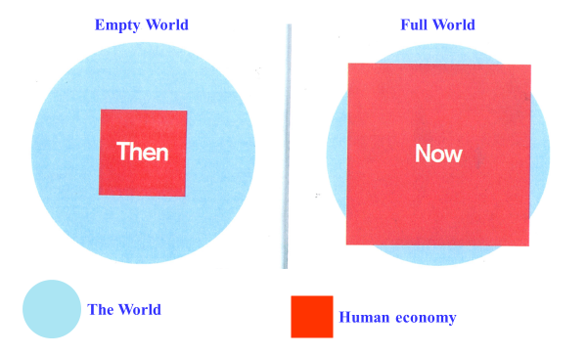
EMPTY WORLD AND THE FULL WORLD
Source: Club of Rome: Simplified after Herman Daly
Labour and Infrastructure limiting factors of human wellbeing
Natural resources and Environmental sinks limiting factors of human wellbeing

Slide 15
WE WANT CHANGES …
BUT WE DO NOT WANT TO CHANGE

Slide 16
REFOCUS …

Slide 17
DPSIR FRAMEWORK

Slide 18
OUR ECONOMY …

Slide 19
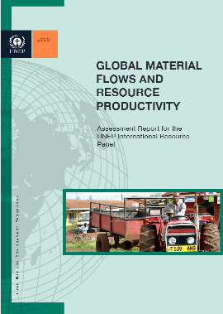
GLOBAL MATERIAL FLOWS AND RESOURCE PRODUCTIVITY (1970-2017)
Consumption has been stronger driver of growth in than population growth
High-income countries are currently consuming 10 times more per person than low-income countries
Global material productivity – USD per kg - started to decline around the year 2000. The decline is attributable to a shift in the share of global output from highly material productive economies to less productive economies.
Global material resource use is expected to reach nearly 90 billion tonnes in 2017 and may more than double from 2015 to 2050. The level of wellbeing achieved in wealthy industrial countries cannot be generalised globally based on the same system of production and consumption

Slide 20
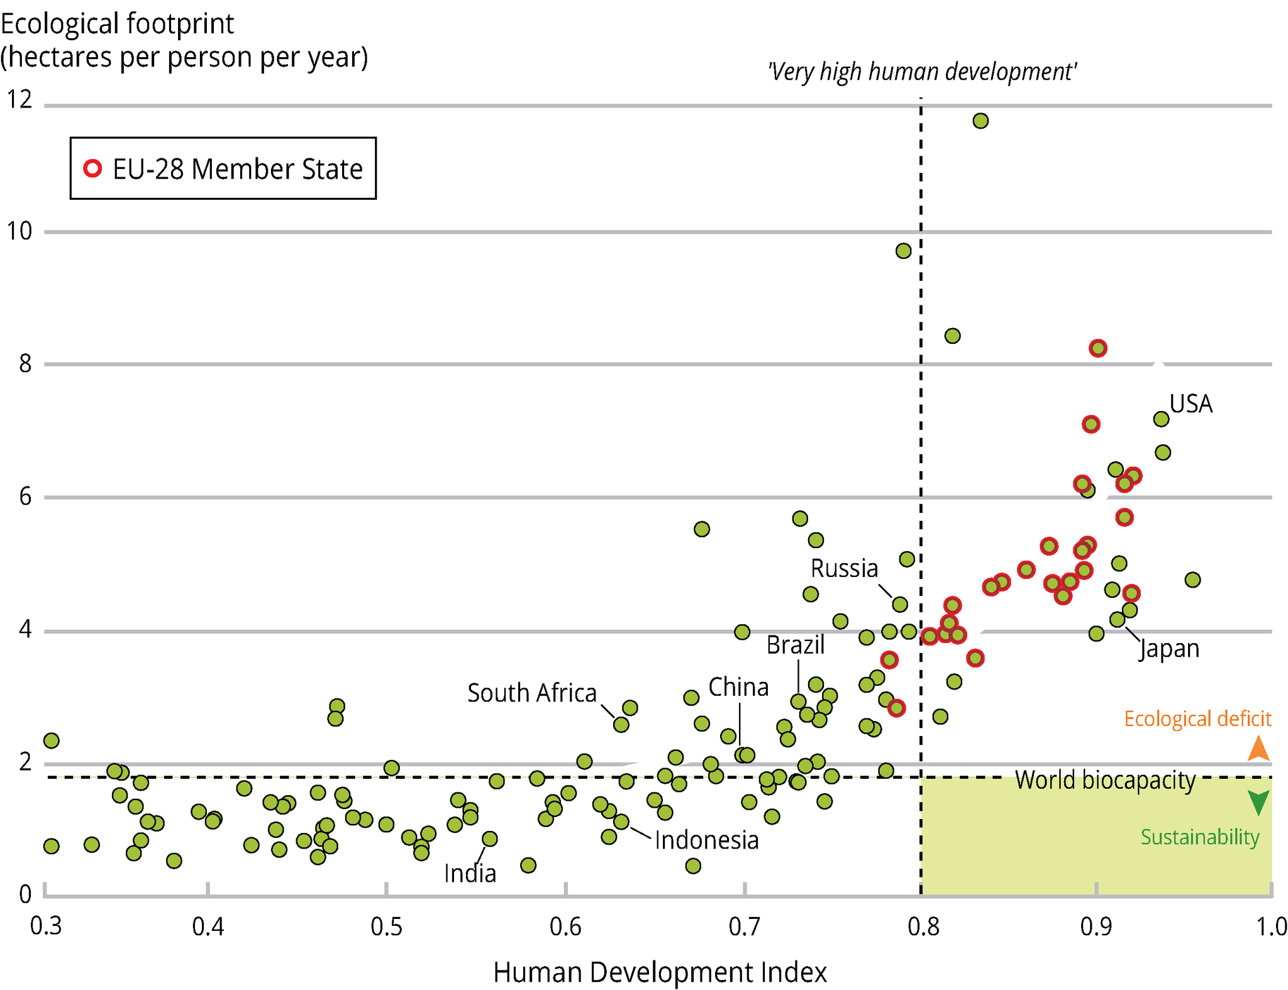
DEVELOPMENT TRAJECTORY …
Source: Global Footprint Network, 2012; UNDP, 2014a
Notes:
it was taken from the UN GEO 5 report. Page 424 of this report indicates the graph was created by plotting UNDP 20009 HDI figures against 2010 Global Footprint Network Figures. The Global Footprint Network site indicates that UK's 2010 footprint is about 5 hectares per person. The 2009 UNDP report indicates that the UK's HDO is at about 0.95. The cluster at the intersection of 5 and 0.9 is thus where the UK is.
This figure plots countries on the basis of two indicators: the Human Development Index (HDI) and the ecological footprint per person.
In order to achieve sustainability, countries must move towards the bottom right hand corner marked in green and as such decouple human development from natural resource use and environmental impacts.
The figure shows that worldwide, no country held that position in 2007.
We should also look to avoid the path the arrows take us: higher human wellbeing yet an increase in the ecological footprint followed by a realisation for the need for change, leading to a decrease in the footprint.

Slide 21
Price Signals:
Finacial Capital Overvalued
Human Capital Undervalued
Natural Capital not Valued
Market
Producers/Consumers
Rational Behaviour
Economic model
Inbuilt Economic, Social, Environmental Inbalances

Slide 22
In the mid-term, except in specific cases, resource shortage will not be the core limiting factor of our (economic) development …
… but the environmental and health consequences caused by this excessive and irresponsible use of resources will be!

Slide 23
ECONOMIC
ENVIRONMENT
SOCIAL
ECOSYSTEMS
SOCIO-TECHNICAL SYSTEMS
providing social needs and value
Notes:
We therefore need a new model of change that will allow us to live well within planetary boundaries. This is what the green economy should be. It aims not only at efficiency, but also at ecosystem resilience and at human well-being.
We need instead to completely rethink our systems and the business models that support them, and a transition to new systems that fulfil societal needs but do so in an essentially sustainable way.
The circular economy is a fundamental part of this transition, and it is a crucial element of the 2050 vision in the 7th EAP. The upcoming communication of the European Commission on circular economy will propose some important steps towards this transition.
Transitions in our socio-technical systems will not occur all at once. Historically, changes in these systems and the business models that support them did not occur in a big bang. Instead, socio-technical systems often emerged via small ‘niche’ innovations in business and other places. Niche innovations happen all the time, but only a few of these niche innovations are successful enough to be up-scaled and distributed more widely.

Slide 24

SAFE OPERATING SPACE
ECONOMIC SYSTEM FUNCTION OF ECOSYSTEM
ECOSYSTEMS
Deposits Emissions Pollution
SOCIO-TECHNICAL SYSTEMS
providing social needs and value
Withdrawals from the ecosystems
Profits privatized
Policy
system
Industry
  Ecosystem
  services
Energy
system
Food
system
Environmental externalities
Environmental externalities
system
system
Mobility
system
Costs socialized
Values
Market
Science
Technology
Notes:
We therefore need a new model of change that will allow us to live well within planetary boundaries. This is what the green economy should be. It aims not only at efficiency, but also at ecosystem resilience and at human well-being.
We need instead to completely rethink our systems and the business models that support them, and a transition to new systems that fulfil societal needs but do so in an essentially sustainable way.
The circular economy is a fundamental part of this transition, and it is a crucial element of the 2050 vision in the 7th EAP. The upcoming communication of the European Commission on circular economy will propose some important steps towards this transition.
Transitions in our socio-technical systems will not occur all at once. Historically, changes in these systems and the business models that support them did not occur in a big bang. Instead, socio-technical systems often emerged via small ‘niche’ innovations in business and other places. Niche innovations happen all the time, but only a few of these niche innovations are successful enough to be up-scaled and distributed more widely.

Slide 25
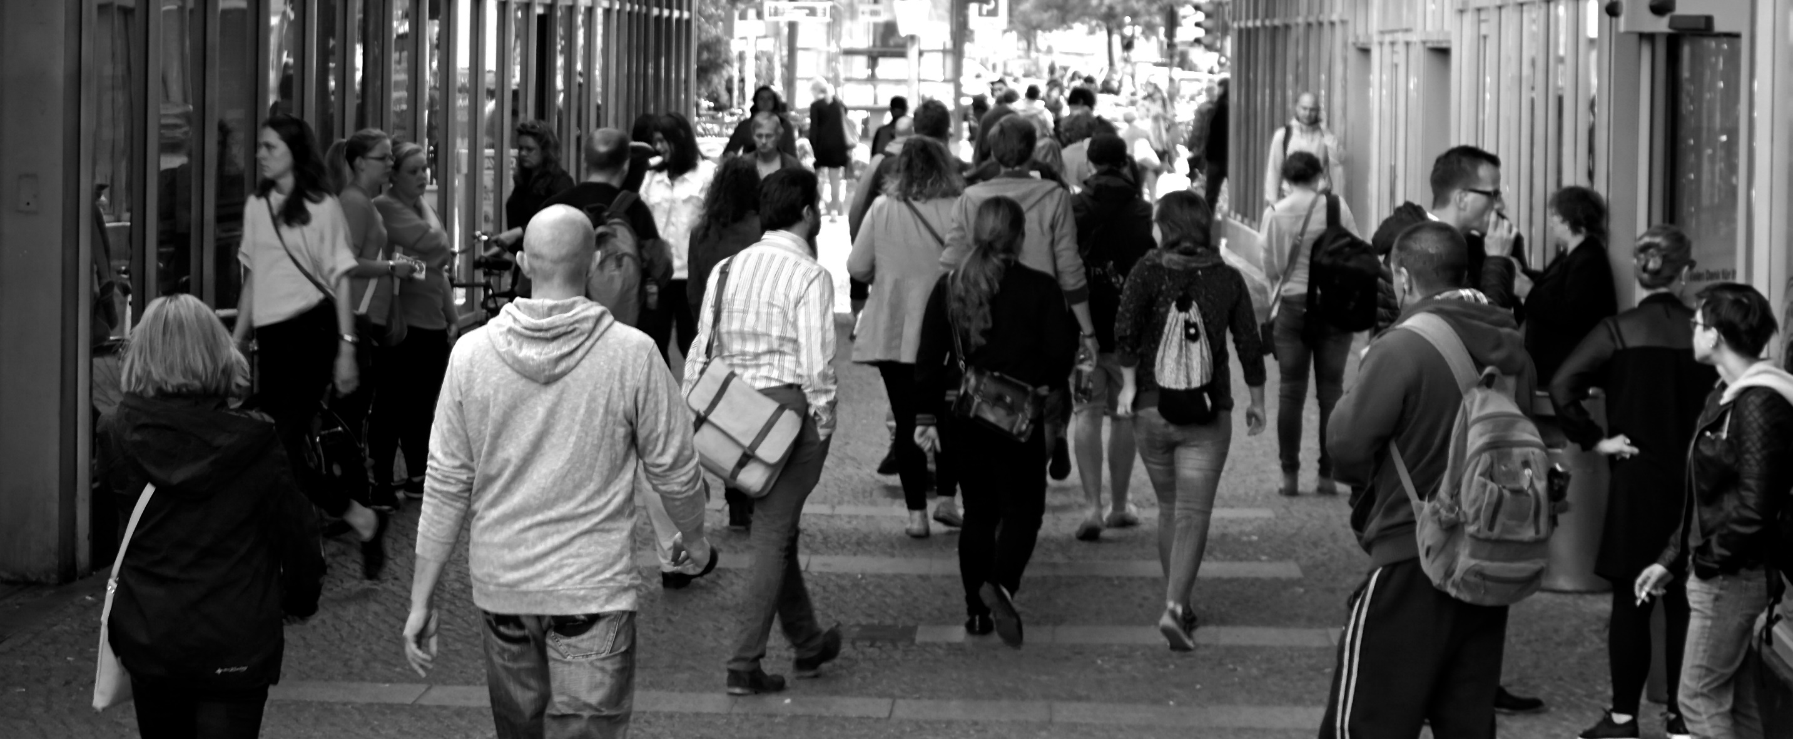
MEASURES OF SOCIETAL DEVELOPMENT THAT INCLUDE NATURAL CAPITAL DEPLETION GROW MUCH SLOWER THAN GDP
Progress per capita³, globally, 1990-2010, real terms
Considerations
C a p i t a l
Economic
Social
Natural
✓
Gross Domestic Product
2,0
Human Development Index
✓
✓
0,8
Genuine Progress Indicator¹
✓
✓
✓
-0,1
Inclusive Wealth Index²
✓
✓
✓
-0,2
1 1990-2005, as later data not available globally,
2 IWI exists in two versions, one unadjusted, and one where adjustments are made for environmental damage, oil capital gains, and total factor productivity. The adjusted version is shown here,
3 Global population growth was 1.6 percent per year during the period
SOURCE: UNEP (2014a), Kubiszewski et al. (2013)

Slide 26
It is not helping if you are walking faster,
if you are walking in the wrong direction!

Slide 27
OUR COMMITMENT…

Slide 28
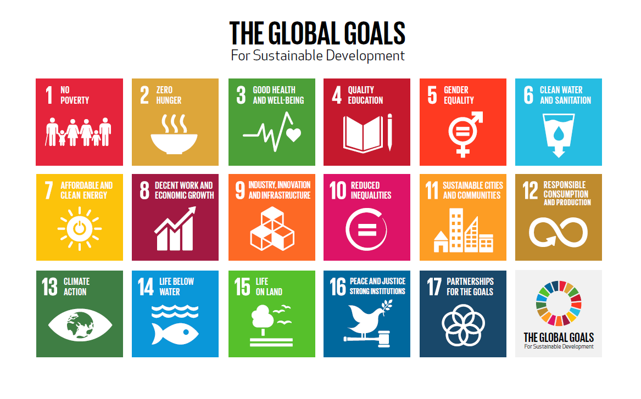

Slide 29
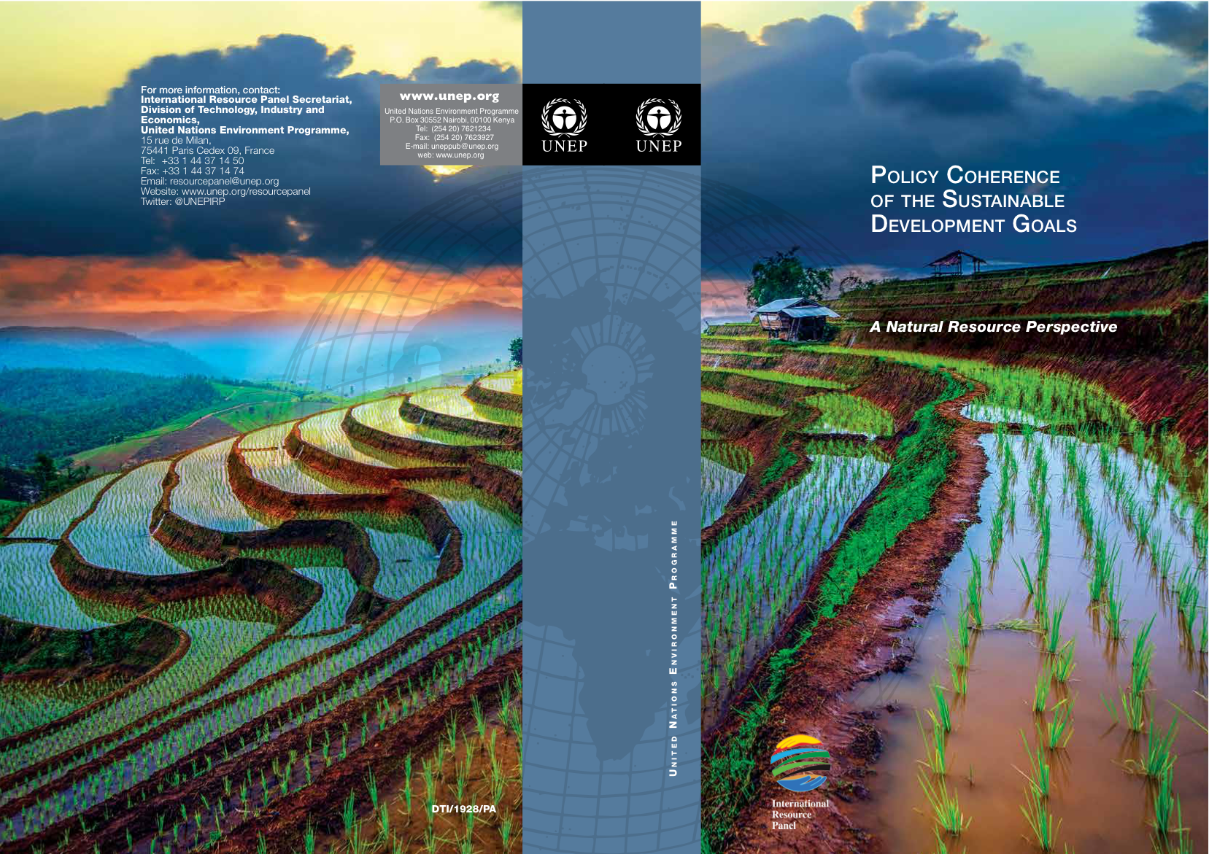
Trade-offs among various SDGs are unavoidable. Sustainable Consumption and Production is the most efficient strategy to avoid trade-offs and create synergies to resolve the development and environmental challenges articulated in the SDGs.

Slide 30
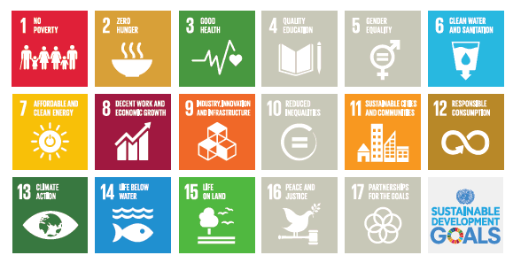
SDGs DIRECTLY DEPENDENT ON NATURAL RESOURCES

Slide 31
RESOURCE MANAGEMENT
CIRCULAR ECONOMY …

Slide 32
DECOUPLING IS THE IMPERATIVE
OF MODERN ENVIRONMENTAL AND ECONOMIC POLICY

Slide 33
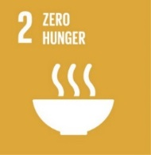
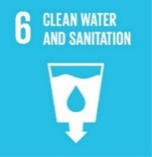
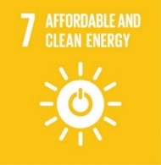
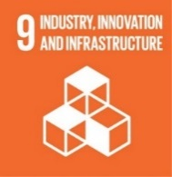
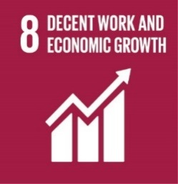
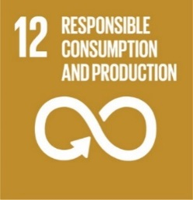
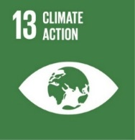
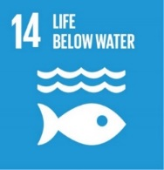
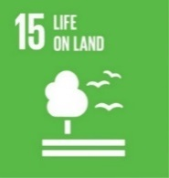
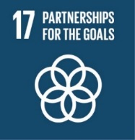
AN IMPLEMENTABLE PARADIGM FOR SUSTAINABILITY TRANSITIONS
Essential development needs and provisioning systems
DUAL DECOUPLING
FOR INCLUSIVE AND SUSTAINABLE GROWTH LINKING DEVELOPMENT AND SUSTAINABILITY:
increasing wellbeing per unit of resource us;
decreasing environmental pressures per unit of resource use
Natural and social capital
required to underpin sustainable development

Slide 34















OUTLINE OF A CIRCULAR ECONOMY SYSTEM
Principles
Preserve and enhance natural capital by controlling finite stocks and balancing renewable resource flows
Renewable materials
Finite materials
1
Regenerate
Renewables
Substitute materials
Virtualise
Restore
Renewables flow management
Stock management
Optimise resource yields by circulating products, components and materials in use at the highest utility at all times in both technical and biological cycles
Biological materials
Technical materials
Farming/ collection
Parts manufacturer
Soil restauration
Biochemical feedstock
Product manufacturer
Biosphere
Service provider
Recycle
2
Share
Refurbish/remanufacture
Biogas
Cascades
Reuse/redistribute
Maintain
Consumer
User
Extraction of
biochemical feedstock
Collection
Collection
Foster system effectiveness by revealing and designing out negative externalities
Minimise systematic leakage
and negative externalities
3

Slide 35












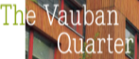



























RESOLVE – A MENU OF BUSINESS ACTIONS FOR A BETTER ECONOMY
Examples
REgenerate
  Shift to renewable energy and materials
  Reclaim, retain, and restore health of ecosystems
  Return recovered biological resources to the biosphere
Share
  Share assets (e.g. cars, rooms, appliances)
  Reuse/second hand
  Prolong life through maintenance, design for durability, upgradability...
Optimise
  Increase performance/efficiency of product
  Remove waste in production and supply chain
  Leverage big data, automation, remote sensing and steering
Loop
  Remanufacture products or components
  Recycle materials
  Digest anaerobic
  Extract biochemicals from organic waste
Virtualise
  Books, music, travel, online shopping, autonomous
  vehicles etc.
Exchange
  Replace old with advanced non-renewable materials
  Apply new technologies (e.g. 3D printing)
  Choose new product/service (e.g. multimodal transport)

Slide 36
CIRCULAR ECONOMY AND CLIMATE CHANGE
Notes:
Aim to decouple growth and dev from consumption of finite resources
Maximisation of asset utilisation (presupposes design + reverse logistics)
On the left side, notion of regeneration means that nutrient loops need to be addressed (currently fragmentation).

Slide 37
CLIMATE
CARBON MANAGEMENT
LAND
WATER
ENERGY
MATERIALS
DECOUPLING
RESOURCES

Slide 38
DIGITAL TRANSFORMATION
AND CIRCULAR ECONOMY …

Slide 39
CIRCULAR AND DIGITAL ARE ON THE SAME DEVELOPMENT CURVE

Slide 40
1
URBAN SYSTEMS
AND CIRCULAR ECONOMY
SHARING MODELS
WASTE RECYCLING
SUSTAINABLE BUILDINGS
ENERGY EFFICIENCY
MOBILITY SYSTEMS
Notes:
Aim to decouple growth and dev from consumption of finite resources
Maximisation of asset utilisation (presupposes design + reverse logistics)
On the left side, notion of regeneration means that nutrient loops need to be addressed (currently fragmentation).

Slide 41
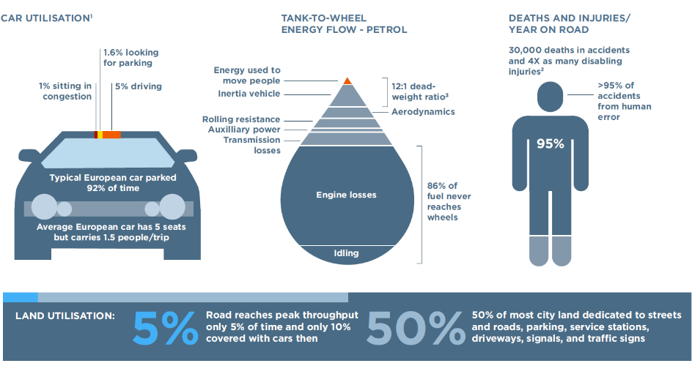
STRUCTURAL WASTE IN THE MOBILITY SYSTEM
ELECTRIFICATION – DRIVERLESS CARS – CAR SHARING
Notes:
We decided to take a different entry point into that debate this time.
We did NOT take resource dependence as the starting point. Although EU remains heavily resource dependent
We did NOT start with environmental degradation although they are getting ever more evident.
We started analyzing the economic waste in our system. And we started in some of the most mature, optimized sectors. Look what you find:
Take mobility: The European car is parked 92 percent of the time
Take food: A full 31 percent of European food goes to waste along the value chain.
Or take buildings: In the built environment, the average European office is used only 35-40 percent of the time, even during working hours.
The European economy has improved in resource productivity but still remains surprisingly wasteful in its resource use and remains, for all practical purposes, a take-make-dispose product model.

Slide 42



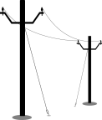
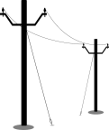





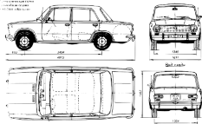
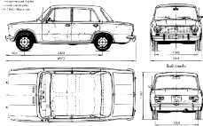
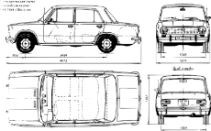

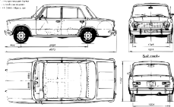




A FUTURE END-STATE COULD LOOK VERY DIFFERENT FROM TODAY’S MOBILITY SITUATION
Illustrative vision
The mobility system of tomorrow
The car of tomorrow
Low CO₂ level
Renewable energy
Connected
3D printed
Long battery duration
Parking spots returned to land
Driverless
X
X
Electric and silent propulsion
  Fewer lanes needed
Wireless contents provided to the user
Zero accidents
Durable, upgradable and easily repairable
Universal access and higher affordability
Shared cars is the norm: autonomous cars on demand
Personalized multimodal route. Car preferred for last mile
Remanu-factured locally
Designed for disassembly
Based on individual preferences (e.g. fast vs. cheap, sharing, etc.)
SOURCE: SUN, ELLEN MACARTHUR FOUNDATION AND MCKINSEY & COMPANY: TEAM ANALYSIS

Slide 43
2
RETAINING VALUE IN CIRCULAR ECONOMY
Notes:
Aim to decouple growth and dev from consumption of finite resources
Maximisation of asset utilisation (presupposes design + reverse logistics)
On the left side, notion of regeneration means that nutrient loops need to be addressed (currently fragmentation).

Slide 44
RETAINING VALUE IN THE SWEDISH MATERIALS SYSTEMS
The Case of Plastics
Offical statistics on plastic waste recycling 53%
Value end of use plastic each year 10 bil SEK
  80% incinerated – energy value 0.4 bil SEK
  16% new plastics 0.9 bil SEK
  4% landfield 0.0 bil SEK
All value retained 1.3 bil SEK
Value retained/Value end of use 13%
Source: Material Economics

Slide 45
RETAINING VALUE IN THE MATERIALS SYSTEMS
Digitalisation is a key tool for more efficient materials handling, innovation in this area is a major industrial opportunity. There is enormous potential for cost reduction and for increasing sophistication of secondary materials production.
Major opportunities include marking technologies, low-cost sensors, real-time tracking, distributed ledgers and automation.
Source: Material Economics

Slide 46
3
Plastics
Land management
Food systems
BIOECONOMY
AND CIRCULAR ECONOMY
Notes:
Aim to decouple growth and dev from consumption of finite resources
Maximisation of asset utilisation (presupposes design + reverse logistics)
On the left side, notion of regeneration means that nutrient loops need to be addressed (currently fragmentation).

Slide 47
AGRICULTURE
FROM CHEMICAL BASED CROP PROTECTION
Pesticides can not be used for targeted crop protection
Current model of pesticides authorisation is one of most conflicting areas in public perception and policy making (Glyphosate, Neonicotinoides, Endocrine Disruptors…)
Nobody is happy (industry, civil society, policy makers)

Slide 48
AGRICULTURE
TO SERVICE BASED CROP PROTECTION
Digitalisation is allowing targeted approach to individual plant protection - precision farming is an already known instrument
But instead of selling pesticides, chemical companies could sell services to protect (hectares of) plants from pests. This would incentivise them to sell less pesticides. By providing service of crop protection combining digital (small robots, drones …) and chemical solutions the use of pesticides would be minimised

Slide 49
CONSUMERS AWARENESS AND BEHAVIOUR
4
Sustainable business practices and consumer awareness and behaviour are important ingredients of fair and circular practice. Transparency and visibility of value chains and production processes are key steps, for gaining a better understanding of the social, environmental and health risks.
Blockchains provide traceability of the information. For example, consumers know exactly what their food contains, whether the goods are genuine and respect workers’ rights. Access to global value chains is important for small businesses in developing economies, as well as for the provision of effective government services that support more inclusive economic and social progress.

Slide 50
EUROPEAN UNION POLICIES …

Slide 51
ANNUAL GROWTH SURVEY 2018
"Competitiveness will be dependent on the ability to move towards more sustainability and resource-efficiency and the ability to exploit the advantages of digital technologies”
Notes:
Janez

Slide 52
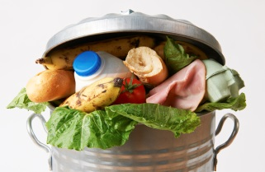
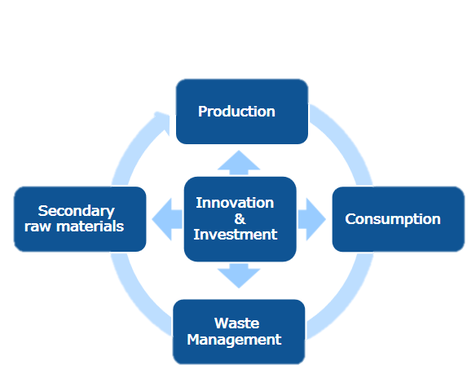
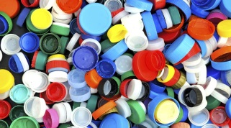
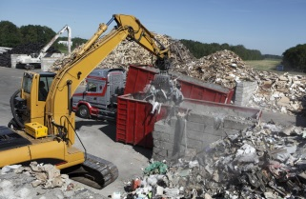
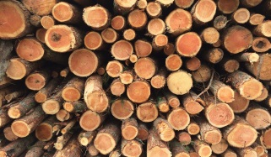
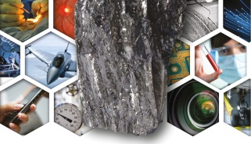
2018 CIRCULAR ECONOMY PACKAGE
6 initiatives
EU ACTION PLAN:
Looking at whole value-chain
Food Waste
Interface Chemicals
Products
Waste
Legislation
A European Strategy for Plastics in the Circular Economy
Revision of Directive on Port reception facilities
Circular Economy Monitoring Framework
Report on critical raw materials
Report on oxo-degradable plastics
Plastics
Constr./Demoli.
Biomass/Biobased
Critical Raw Mat.

Slide 53
DIGITAL EUROPE PROGRAMME
5 specific objectives
High Performance Computing
Artificial Intelligence
Cybersecurity and Trust
Advanced Digital Skills
Deployment, best use of digital capacity and interoperability

Slide 54
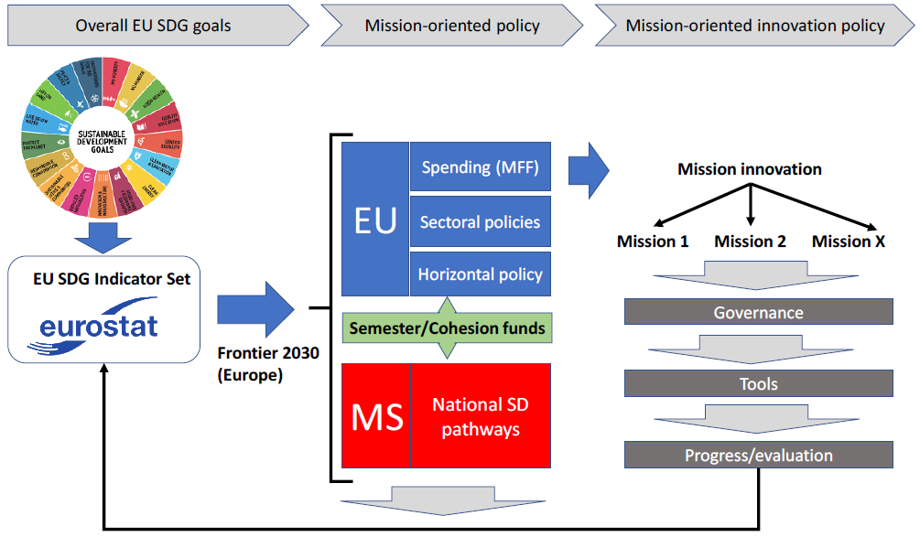
AN EVOLVING PARADIGM FOR INNOVATION POLICY?

Slide 55
European Commission and EU member states have unique opportunity and responsibility to align all existing funding instruments and policies (CAP, FP9, Cohesion policy, Trade …) to support this transition.
Agenda for Sustainable Development 2030
Next MMF likely for the period 2021-2027
AND IF THIS WILL NOT BE DONE …

Slide 56
The time is gone, the song is over,
Thought I’d something more to say
(Pink Floyd)

Slide 57
LEADERSHIP
GOVERNANCE…

Slide 58
RESPONSIBILITIES OF THE BUSINESS SECTOR
Aligned with the SDGs
From being a pure product or service providers managing the risks of the company through profit maximisation
To socially responsible companies managing also the risks of the society

Slide 59
SYSTEM INITIATIVE ON ENVIRONMENT AND NATURAL RESOURCE SECURITY
World Economic Forum – Annual Meeting 2018
Complexity and scale of these challenges requires a space that allows actors with responsibility for those environmental governance mechanisms to be able to consider and experiment with both new forms of collaboration and more „systemic“ approaches ... through promoting multi stakeholder cooperation, more agile governance (including sub-state actors, such as cities, states and provinces), the use of new technologies, and enhanced accountability and transparency.

Slide 60
System Initiative on Environment and Natural Resource Security
World Economic Forum – Annual Meeting 2018
The challenge seems to not be one of not inadequate scientific evidence anymore; rather it is one of cooperation and implementation.
There is a deepening perception of a lack of synchronicity between economic and environmental policy responses to global risks.

Slide 61
GOVERNANCE
REDEFINING SOVEREIGNTY

Slide 62

TO CONCLUDE …

Slide 63
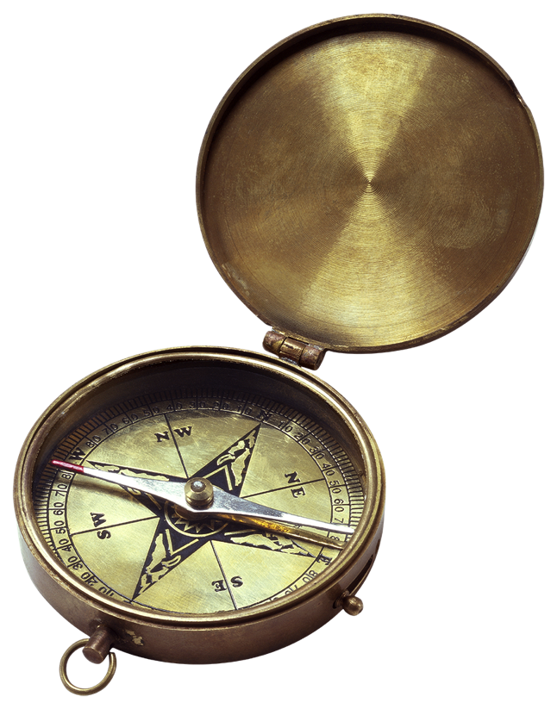
NEW ECONOMIC MODEL BASED ON SCP INTEGRATING ALL PILLARS OF SUSTAINABILITY IS
WE HAVE TO FIX A BROKEN COMPASS
(PAVAN SUKHDEV)
NECESSARY
AND UNAVOIDABLE
SCIENCE

Slide 64
ASSESSING GLOBAL RESOURCE USE
2017 IRP Report
Recommended policy strategies
Set targets and measure progress
Act on key leverage points across all levels of governance
Take advantage of leapfrogging opportunities
Implement a policy mix that builds incentives and corrects market failures
Promote innovations toward a circular economy
Enable people to develop resource efficient solutions
Unlock the resistance to change

Slide 65
TRANSITION TO A SUSTAINABLE ECONOMY
Is an in-debth system change.
It will not appear by waiting for the leadership of others, be the leaders on your level of governance and authority … in politics, in business, academia, civil society, in making your investment decisions …
If we are to avoid globally extensive and inter-systemic crisis and frequent conflicts than let’s get serious about implementing what we have agreed in SDGs. Changes are unavoidable and humans are supposed to be intelligent. It is high time to prove it.

Slide 66
AND THE ROLE OF A
DIGITAL TRANSFORMATION …
Digital Transformation is not an end in itself.
It should play a central role in addressing the challenges we are collectively facing.
It is an enabling condition to change our current economic model into a more sustainable one and it is essential to make circular economy a reality.
It is an invaluable ingredient for a better future, if used in a responsible way … like all breakthrough human inventions

Slide 67
Transition to Sustainable Economy
(Circular Economy)
Digital
Transformation

Slide 68
Economy transition
(based on digital transformation)
is a major new opportunity for the innovation, new development opportunities, new jobs
And alternative ...
I would rather not think and talk about it!

Slide 69
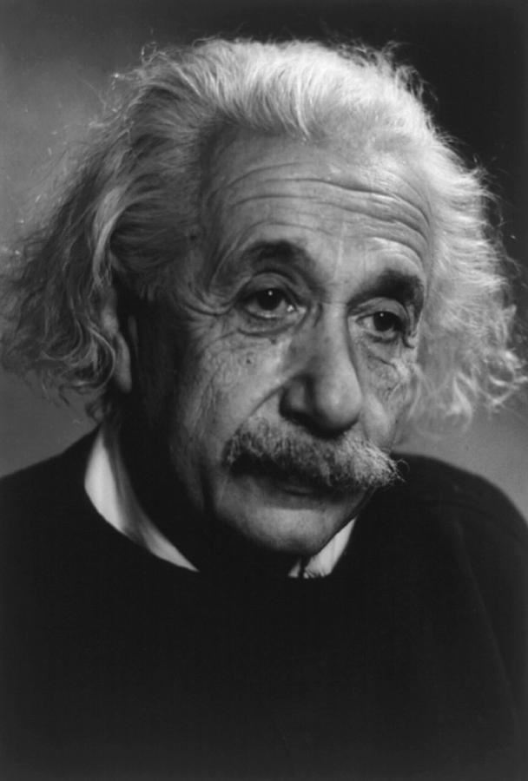
WILL IT BE EASY?
ALBERT EINSTEIN
When asked why it is that mankind has stretched so far as to discover the structure of the atom, but we have not been able to devise the political means to keep the atom from destroying us he replied:
“That is simple, my friend. It is because politics is more difficult than physics”

Slide 70

THANK YOU
For more information
Contact IRP Secretariat at resourcepanel@un.org
Visit our website at http://resourcepanel.org/

