Slide 1
BTC Company
Business Transformation Center
Mark Kalin,
Deputy Chief innovation and Digital Officer
June, 2018

Slide 2
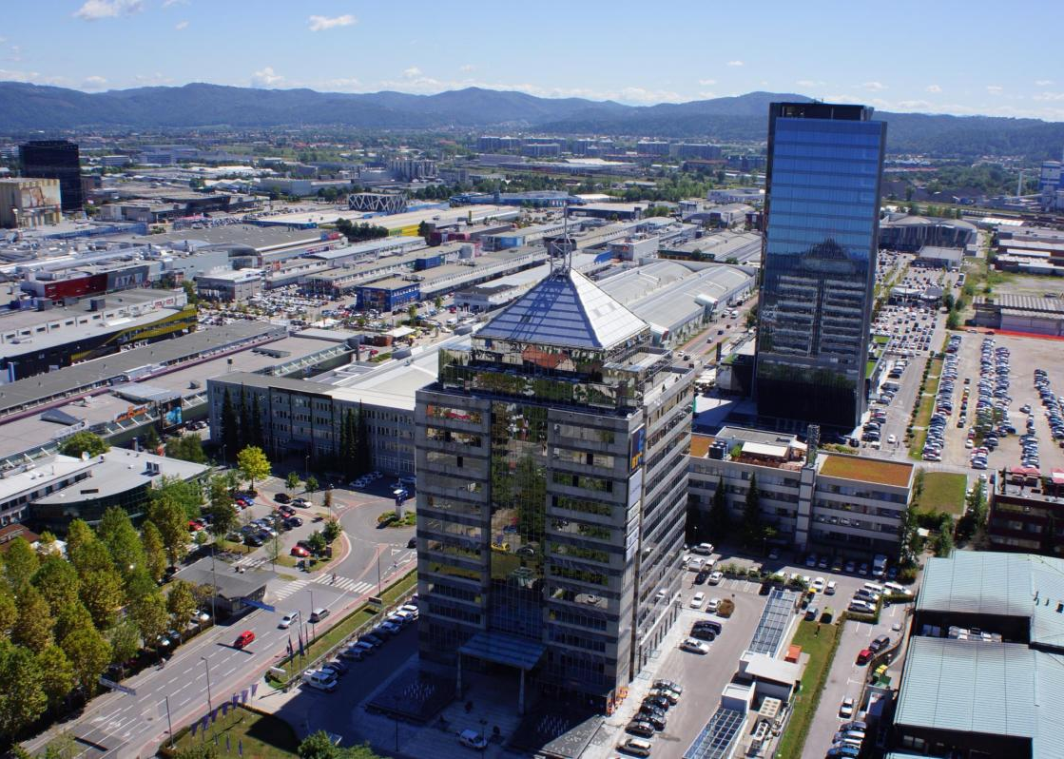
BTC City represents one of the largest business, shopping, entertainment, recreational and cultural centers in Europe.
More than 21 mio visitors per year
3,000 companies
More than 450 shops
70 food restaurants
8,500 free parking spaces
12.5 mio cars per year
Areas:
Mega Cinemaplex
Aqua Park
Entertainment Centres
Recreation Centres
Medical Centres
---------------------------------
Total 400.000 m2

Slide 3
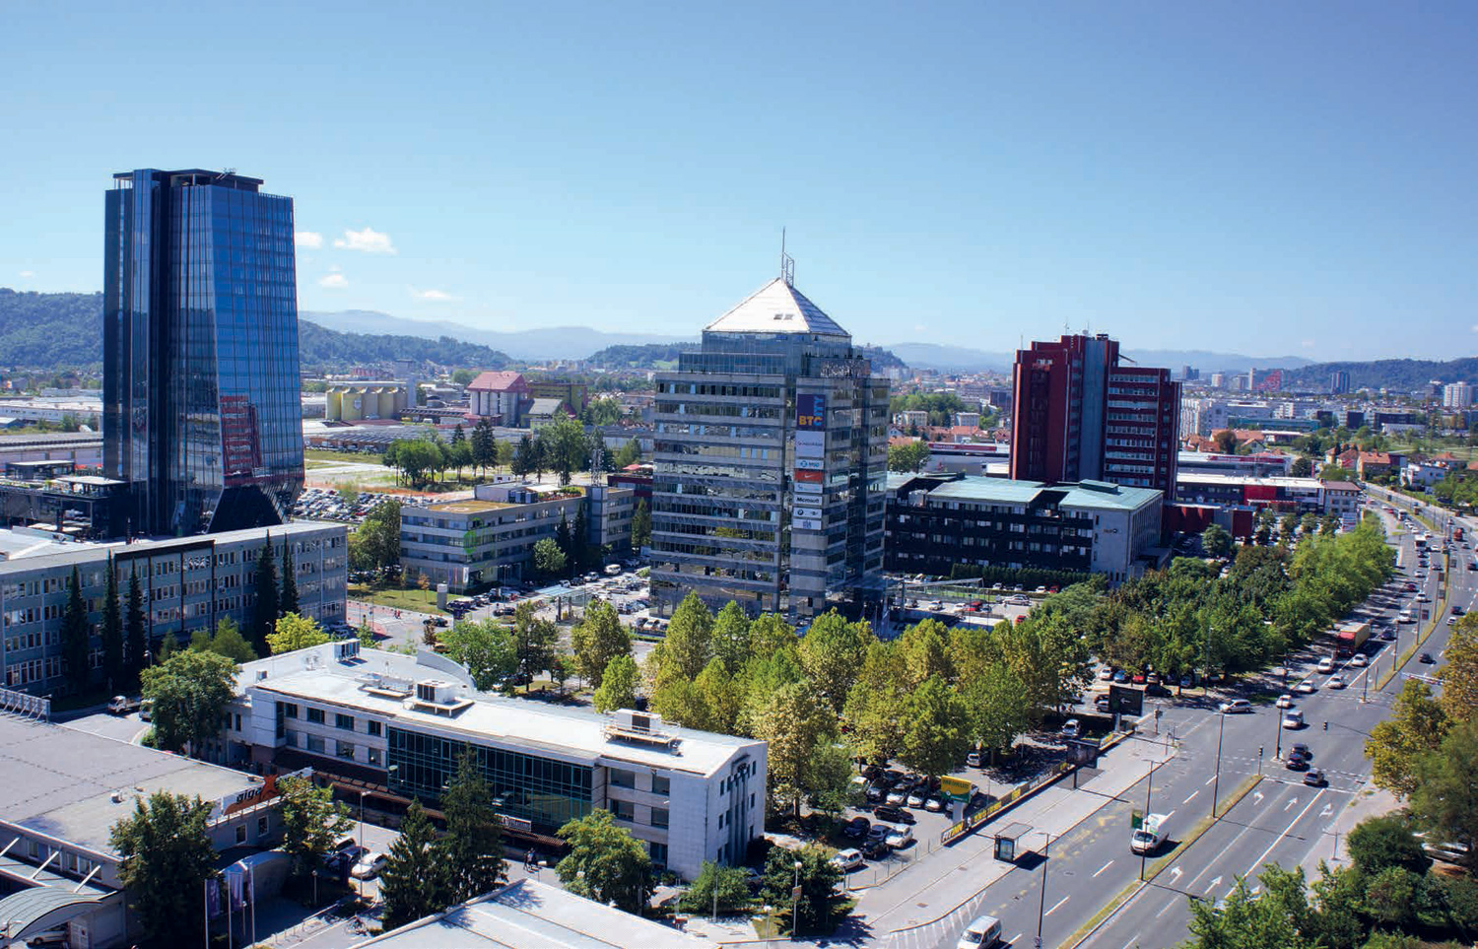

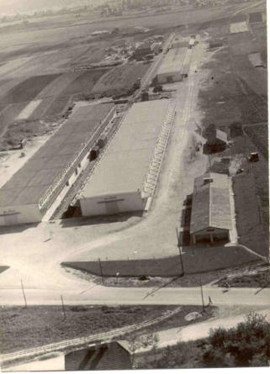
More than 60 years of tradition:
2012 – Mission: Green
2016 - Innovative City Digital transformation
1954 - Central Warehouses
1998 – BTC City
1993 – Shopping Center
Ljubljana
BTC key business segments:
BTC City
Logistic Centre
Property and Asset Management
Mission: Green
Innovation and Digital City

Slide 4
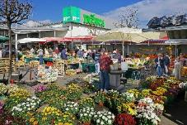
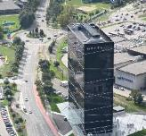
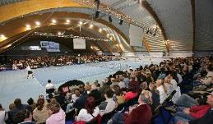
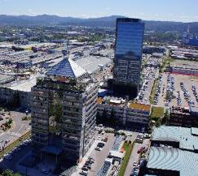
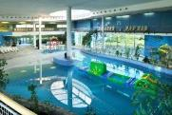
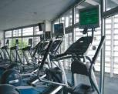
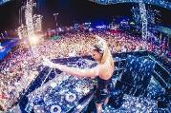
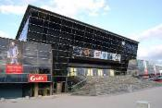
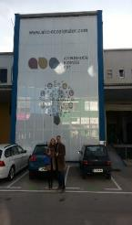
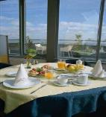
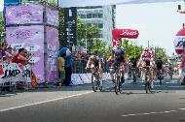
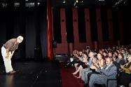
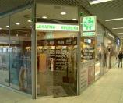
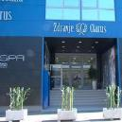
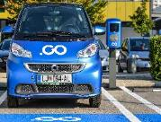
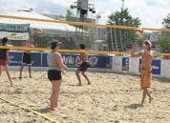
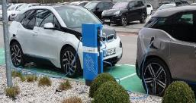
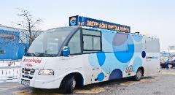
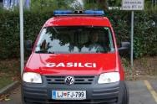
Innovative, Smart City- BTC CITY
Green market
Hotel
Tenis
Business towers
Water park
Fitness
Exciting entertaining
Multiplex cinema
Restaurants
National and international cycling events
ABC accelerator for startups
Theater
Pharmacy
Medical center
Electric car charging stations
Volleyball playground
Free shuttle bus
Fire brigade

Slide 5










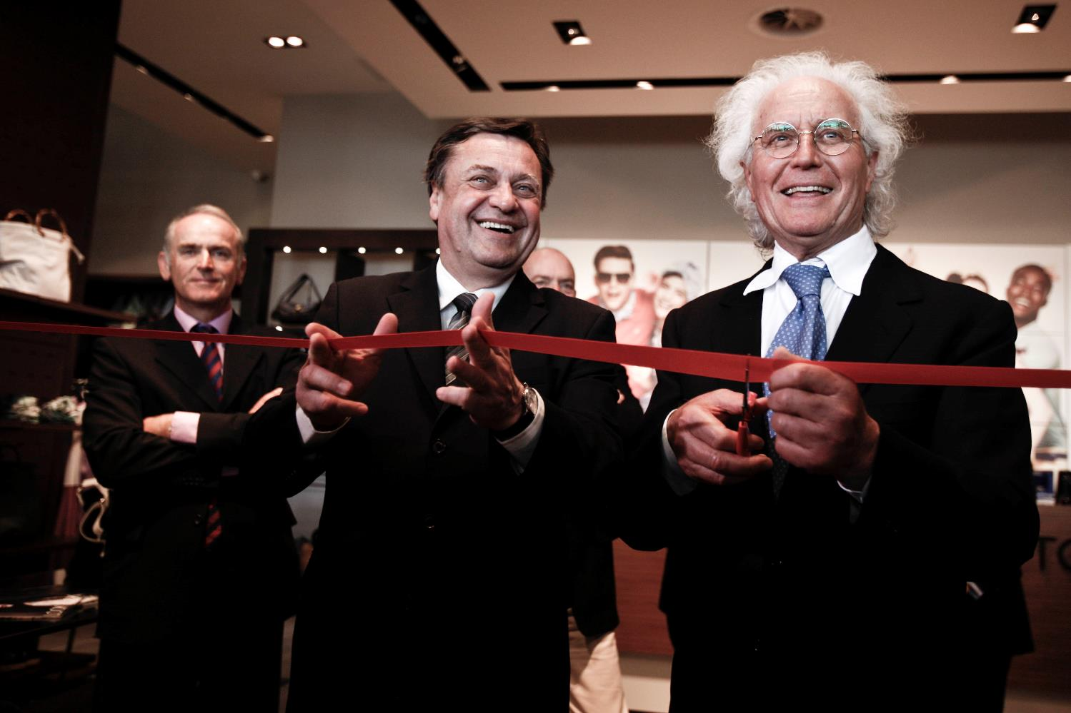






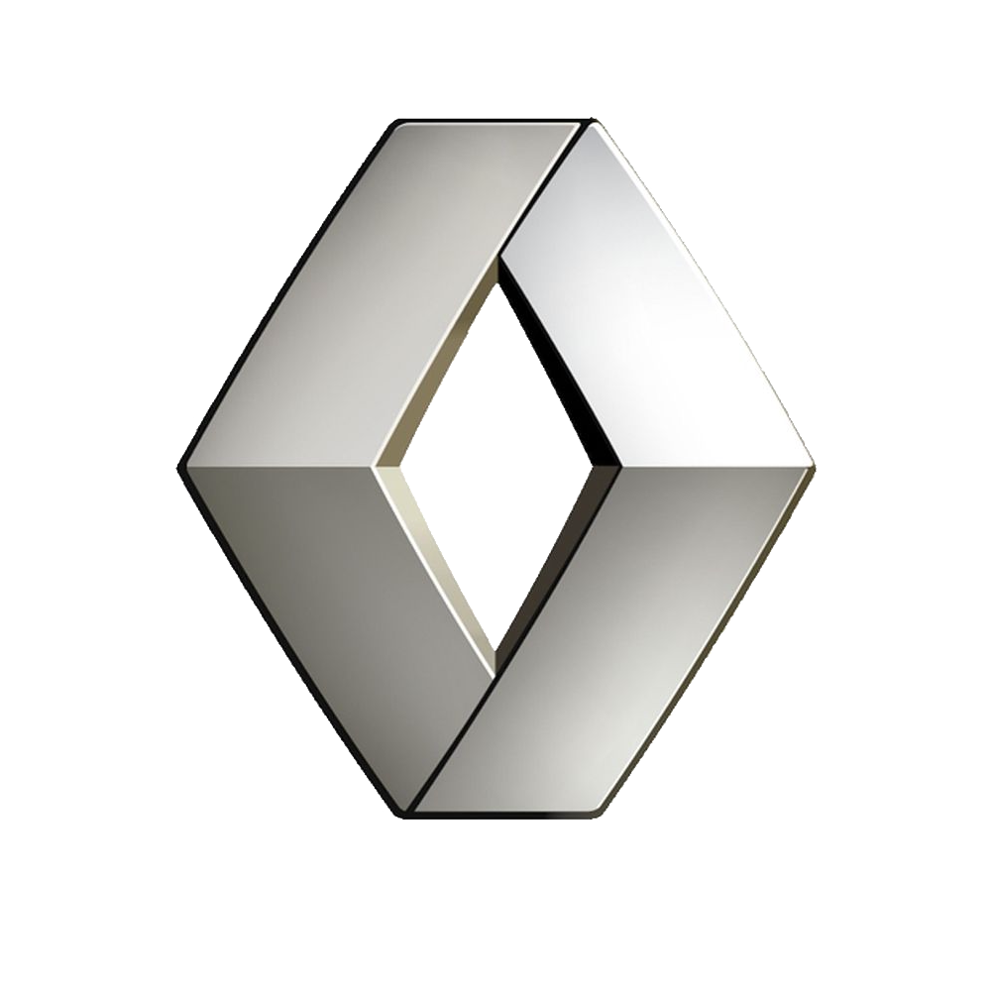



With strong global multinational companies we are building Interconnecting Ecosystems

Slide 6
BTC as Business Transformation Center
(BTC Living Lab - unique Innovative concept)
TRANSFORMING
COMPANIES
TESTING
PROMOTING
SELLING

Slide 7

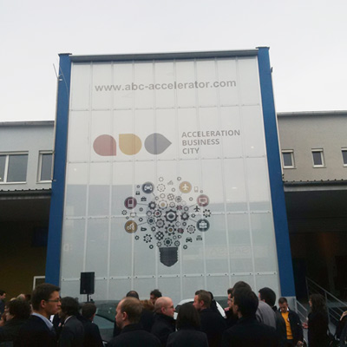
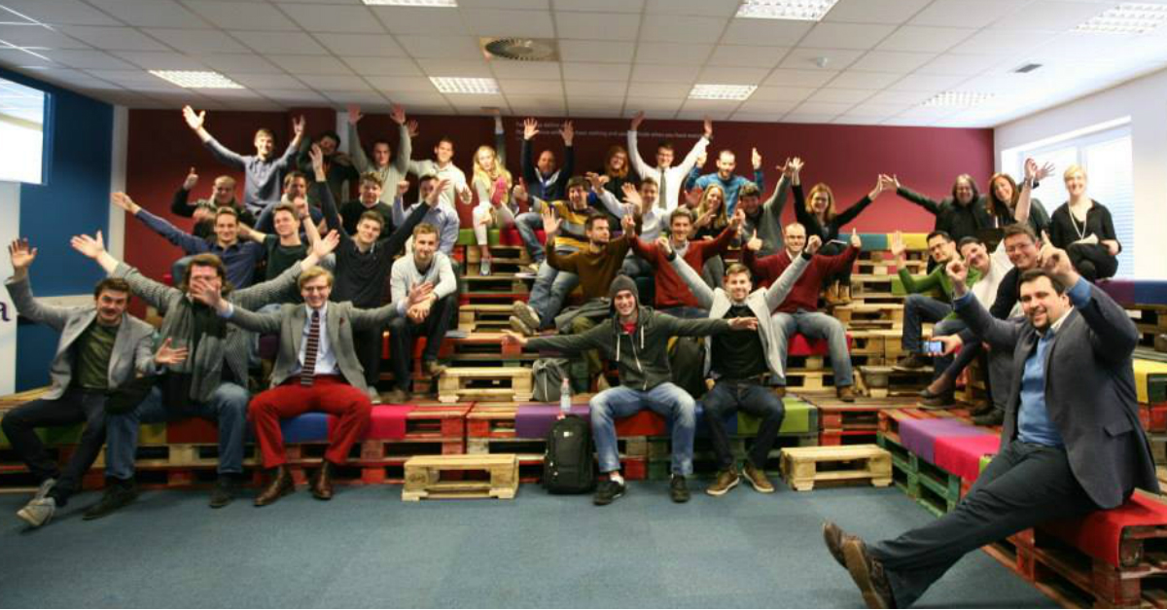
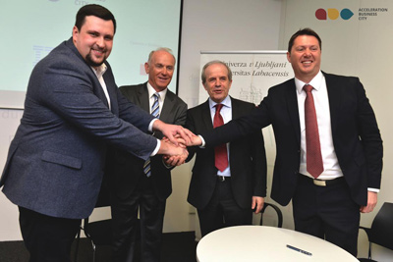
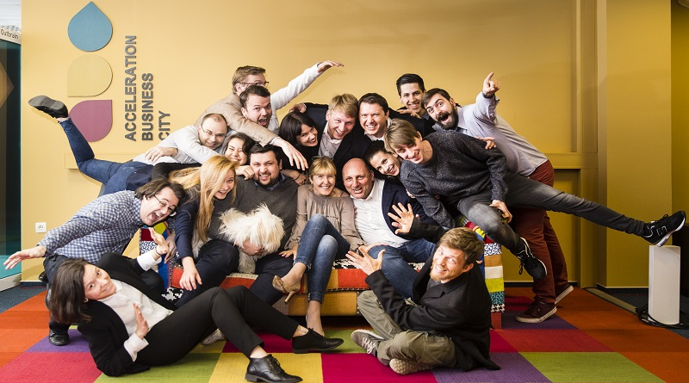
BTC City as Innovative City: ABC Accelerator
In March 2015 BTC Company co-created a new development story of Slovenia:
ABC Accelerator (helping young companies - startups, enterprises and business partners build the ecosystem of innovation)
Notes:
Od maja lansko leto, ko je BTC soustanovil ABC pospeševalnik in s tem v središče “mesta” postavil inovacijsko središče, je zgodba pospeševalnika prerasla vse okvirje in postala ne samo največja Slovenska zgodba o uspehu, temveč je močno prerasla slovenske meje. V letošnjem juniju se je namreč odprla izpostava ABC pospeševalnika v Munchenu, pred samo dvema tednoma (24.Septembra) pa smo bili deležni otvoritve ABC pospeševalniku v srcu Silicijeve doline - San Jose-ju. Predvsem je izjemno to, da gre za pospeševalnik v povsem privatni lasti in povsem slovenskih korenin ki je z svojo edinstveno zasnovo in posvlonim modelom uspel postaviti ob bok navečjih svetovnih pospeševalnikov in ima ambicijo postati najboljši na svetu. Ekosistem ki nastaja, pomeni za mlada startup podjetja most med EU in ZDA z Slovenijo v osrčju, kjer se izvaja začetno rekrutiranje mladih podjetij (v trenutnem programu z naslovom IoT – Internet of Things, so prijavljena mlada podjetja poleg slovencev, že iz vseh koncev sveta)
Pa poglejmo kako je koncept zasnovan:

Slide 8
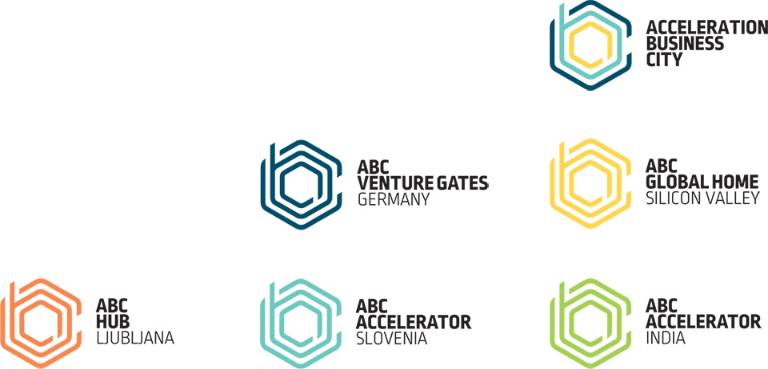
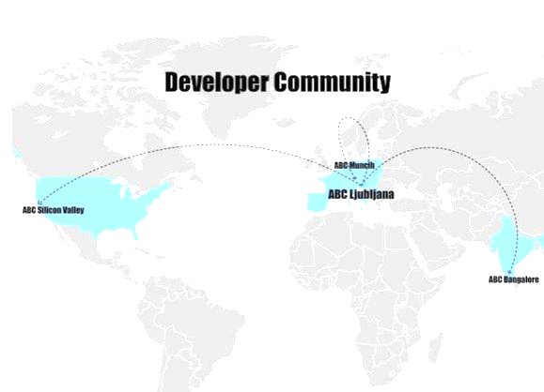
BTC City as Innovative City: ABC Accelerator
In last 3 years we accelerated 90 startups from 24 different countries.
ABC Accelerator became the best accelerator in Central Europe on 25th of November 2017
Currently running our 6th program for startups – DEEP TECH
We have all-inclusive package with apartments, developers, legal etc.
Collected more than 30 mil of investments into our startups.
Created more than 1,000 new jobs.

Slide 9
Engine of Innovation: ABC Accelerator

Slide 10


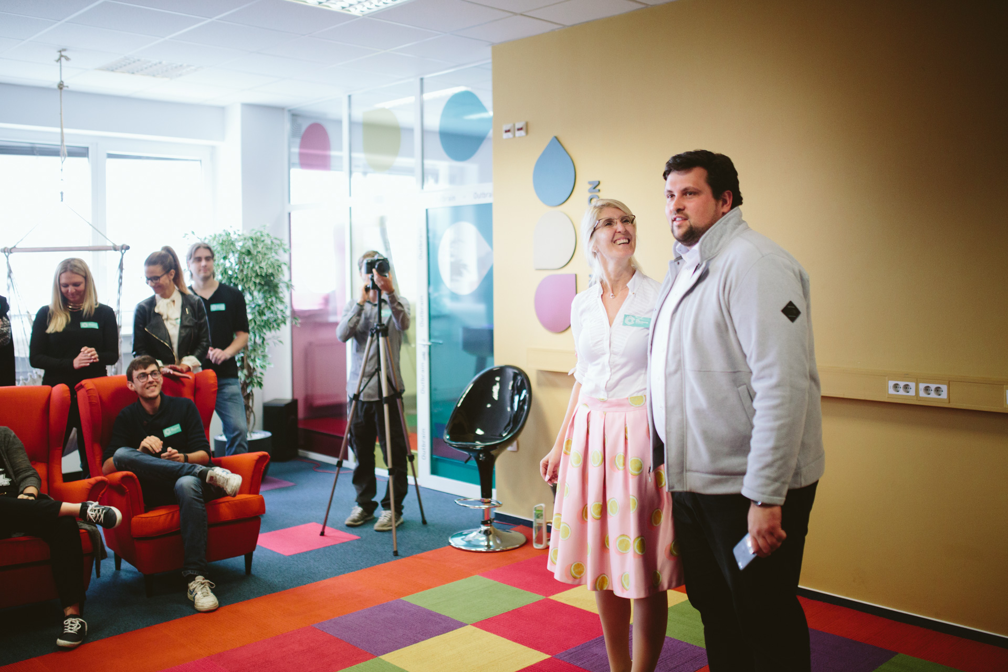
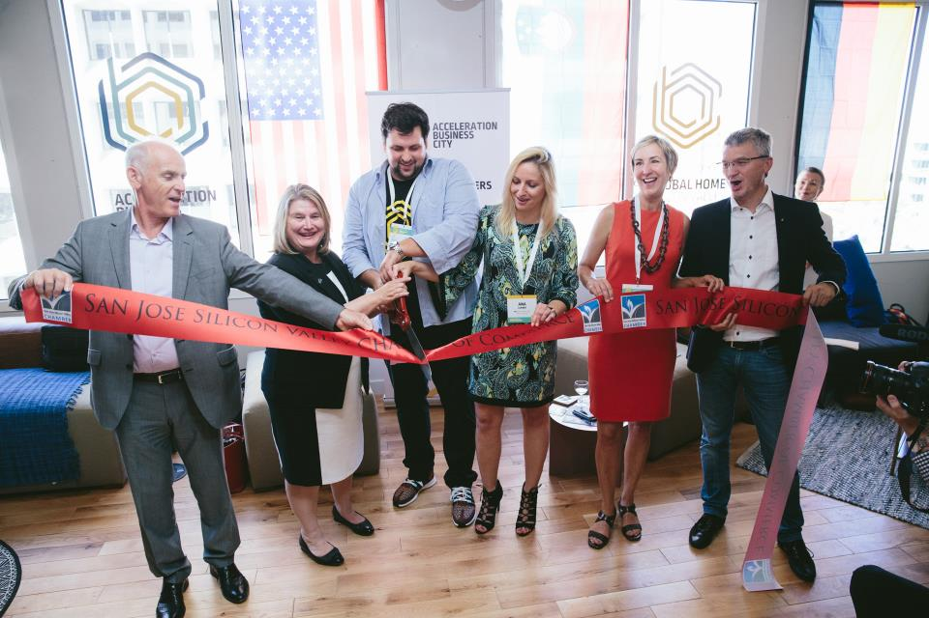
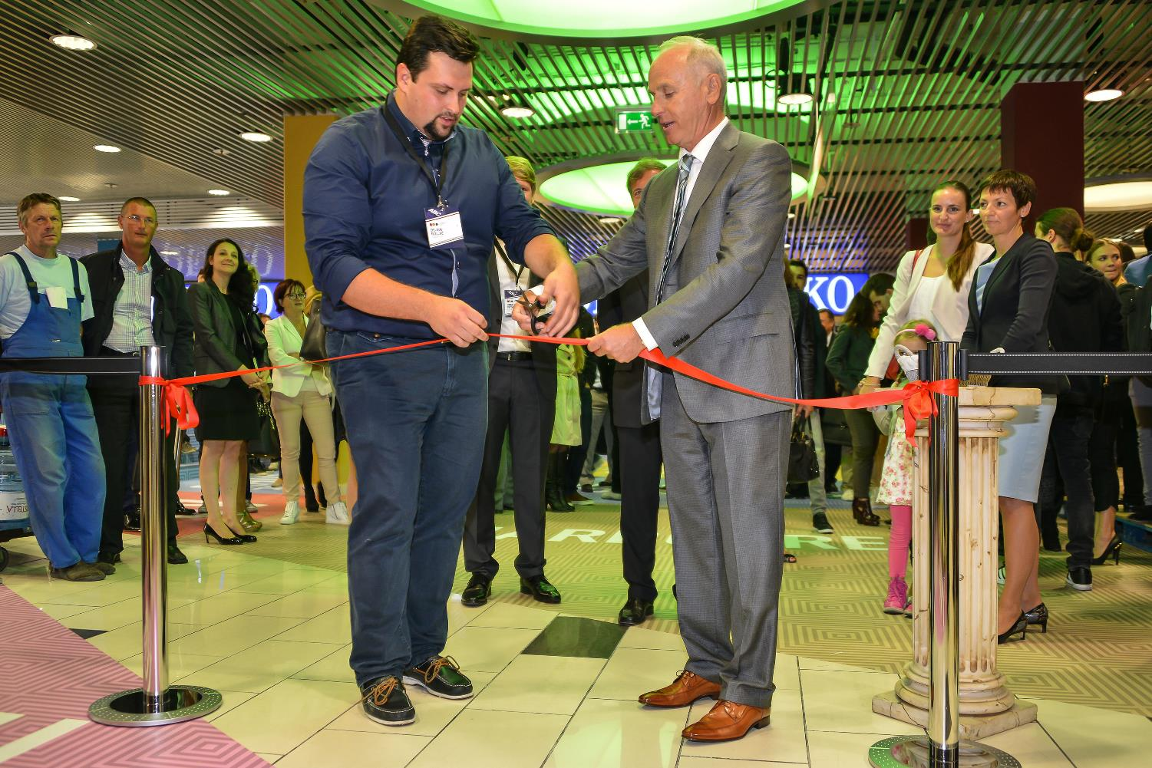
ABC Accelerator Ecosystem: Bridge between Europe and USA, with Slovenia as a CORE
March 2015 June 2016 Sept 2016
Ljubljana
Munich
Silicon Valley
ABC HUB
Co-working space
Sept 2015
Entrepreneurial ABC Accelerator Ljubljana, spread on more than 12.000 ft2, began with the work activities at the end of March 2015, in the creatively renovated offices at BTC City, the largest retail, entertainment, and business area in the region, with over 4500 different businesses located there.
Acceleration program, for early stage startups with a finished product.
ABC Venture Gates Munich is the business center of Europe, spread on 10.000 ft2 and set up for later-stage startups. The city has the largest share of major companies within the whole DACH region contributing to the biggest B2B market
Acceleration program for advanced startups and SMEs looking for the investment more than 1.5Mio.
ABC Global Home Silicon Valley, spread on more than 13.000 ft2, recruits the finest international startups and exposes them to Silicon Valley’s wealth of resources and capital while changing their mind-sets by involving them in the dynamic creativity and exceptional driving forces of Silicon Valley.
ABC Silicon Valley is the headquarters of the ABC With its personalized approach and program, it represents a global home for most advanced startups.
Spread over 2,000 m² in Hall D (Emporium) in BTC City Ljubljana, ABC Hub provides everything startups and young companies need for successful development: creative office space, flexible and fixed co-working spaces
Notes:
Pa poglejmo kako je koncept zasnovan:
Kot rečeno, se v Slovenski pospeševalnik v program prijavijo mlada startup podjetja iz vsega sveta (60 podjetij na leto). Po uspešno zaključenem programu, se podjetja lahko odločijo, da ostanejo v Sloveniji, za kar smo v BTCju v Hali D pod Emporium-om uredili poslovno okolje ABC HUB, kjer je na 2000m2 pripravljeno vse, da lahko mlada podjetja nadaljujejo s poslovanjem in poslovnim povezovanjem. V kolikor pa ima podjetje potencial in željo takoj nastopiti na najzahtevnejšem trgu EU, Nemčiji, pa jih ABC ekipa sprejme v Munchenu in jih skozi program in mentorske povezave nudi okolje za nadaljevanje. Finalna stopnja oz. startupi z največjim potencialom pa so sprejeti v Silicon Valley, kjer se pričakujejo največje investicije in izjemna rast. Model je otrje zasnovan tako, da omogoča stopenjsko prehajanje na višje nivoje, glede na zrelost in razvojno fazo podjetja ter seveda poslovni potencial.

Slide 11
ABC Enterprise Accelerator for Corporates:
www.abc-edg.com.

Slide 12
ABC Enterprise Accelerator for Corporates:

Slide 13

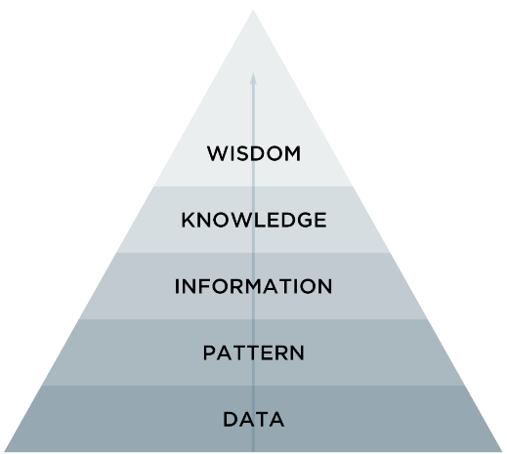
Transformation into a Smart City – using BIG DATA

Slide 14
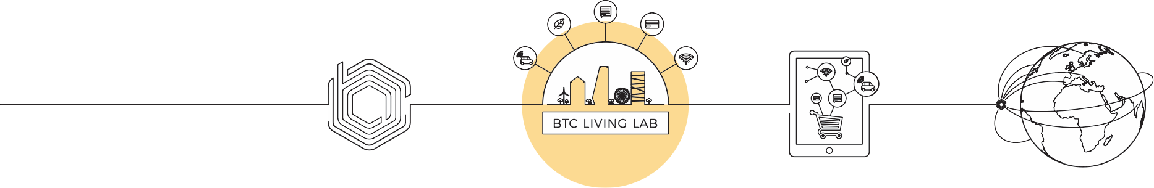
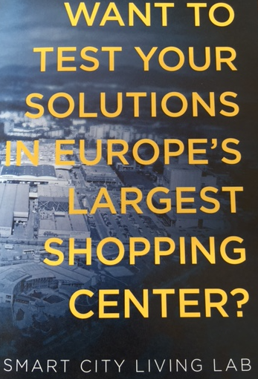
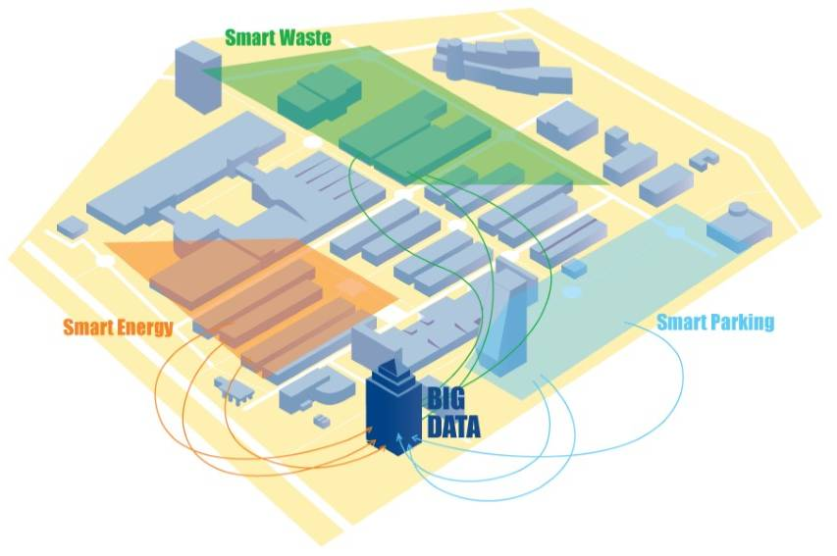
BTC Living Lab
From Accelerator to BTC Living Lab - testing area for Smart City solutions.
BTC Living Lab: creating a platform of BTC as a physical location, which allows global and local corporations to test "real-production”.

Slide 15
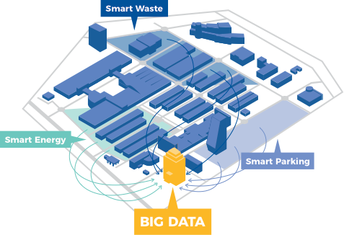
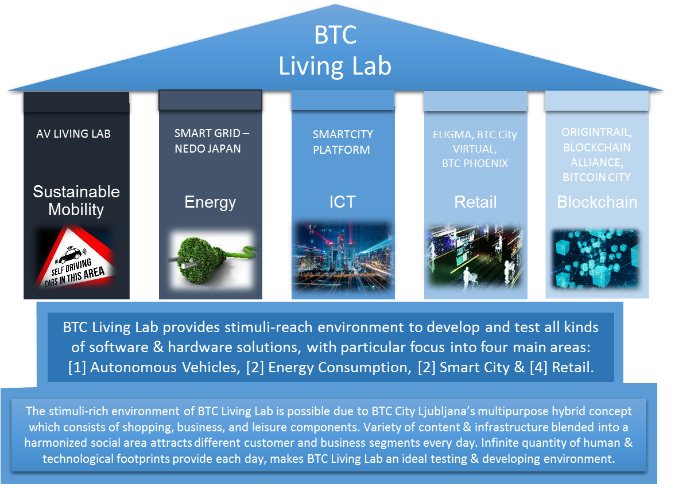
BTC Living Lab
testing, promoting and selling various solutions
Solution areas and competencies BTC Living Lab is focusing on:

Slide 16
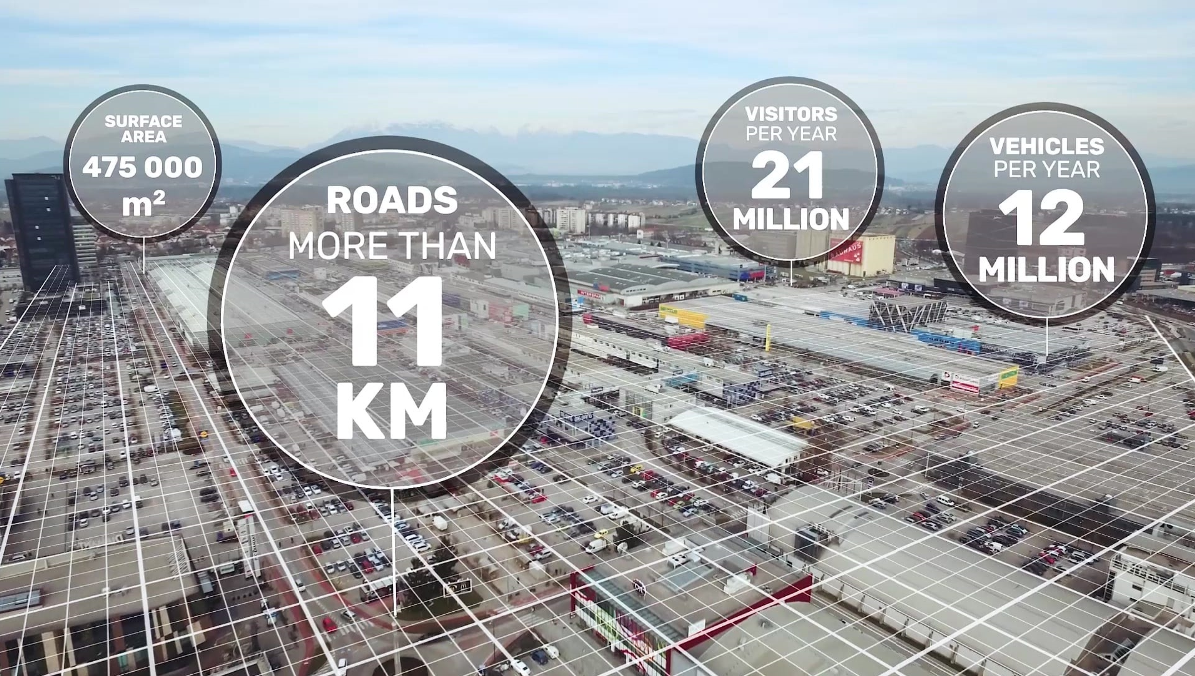
BTC Living Lab -
AV (Autonomous Vehicle) Living Lab
Conveniently located in the heart of Europe, Slovenia, and Ljubljana, the AV Living Lab provides an ecosystem that connects different businesses, partners, talents, and a startup hub – the powerful knowledge and unlimited possibilities for AV concepts to prosper.
AV Living Lab, BTC City Ljubljana http://avlivinglab.com/
the real life environment, which offers 24 hours a day, every day of the year offers a wide range of situations and interactions
15 roundabouts wide network of connected devices and video surveillance with more than 200 CCTV cameras
Speed ​​limit: 30 km/h
average visit time 25-90 min *

Slide 17
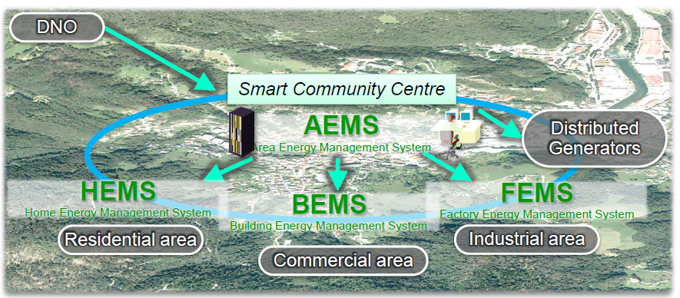
BTC Living Lab – Smart Grid
NEDO Japan project
New solutions for innovative use of electricity with new network, storage and management systems (smart grid).

Slide 18
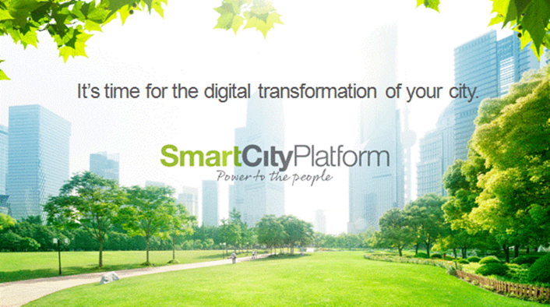
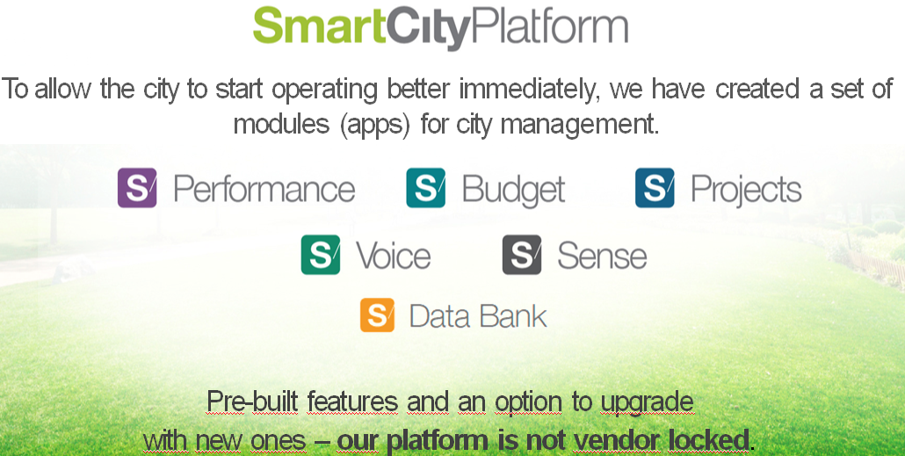
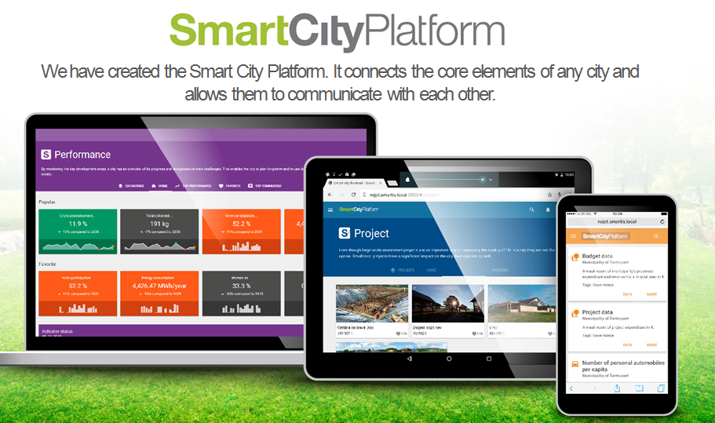
BTC Living Lab -
SmartCity Digital Platform
A key platform for the concept of BTC Living Lab (for the collection and management of data to our partners, who will participate in the Living Lab).
https://www.youtube.com/watch?v=v_MX83KfH24

Slide 19

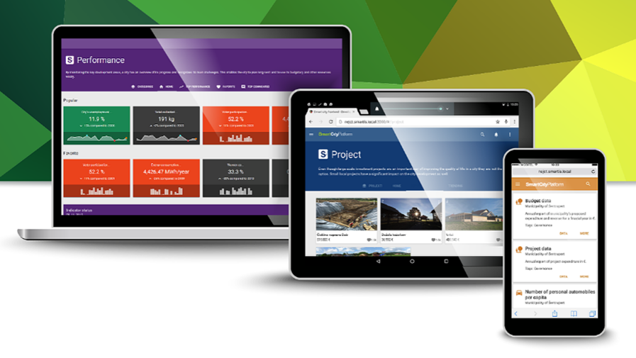
Smart City Platforma
Platform consist of:
Databank: collecting data
Marketplace: digital solutions catalogue
Performance: measuring of KPIs
Project: strategic projects
Sense: sensors
Voice: employee engagement (collecting ideas)
https://btc.scplatform.eu/performance

Slide 20
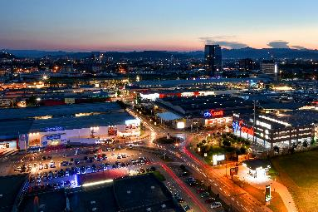
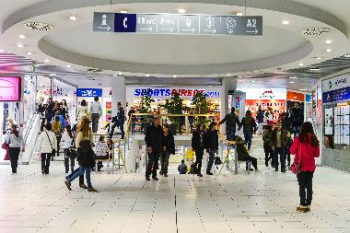
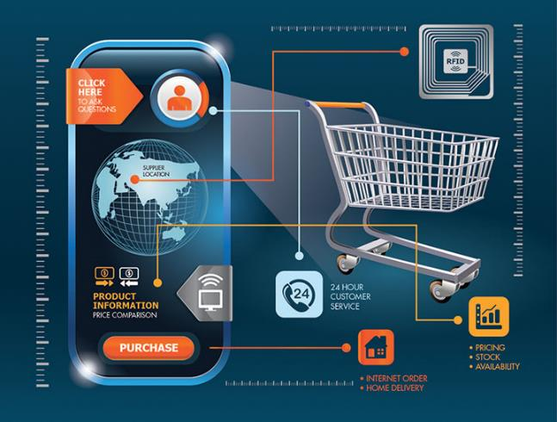
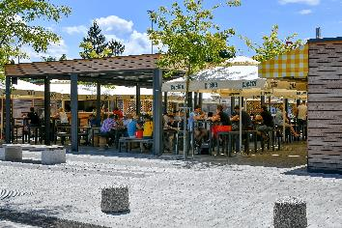
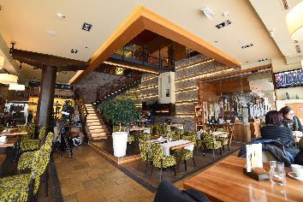
About BTC Retail Living Lab pillar
With its 450 shops, 70 food and drink vendors, and different types of sporting facilities, BTC City Ljubljana represents the largest customer migration point in Slovenia, attracting more than 21 million visitors per year.
Wits such a setting it represents an ideal testing environment for the latest multichannel solutions, developing in the retail arena.

Slide 21

BTC Living Lab - Retail
Eligma project
BTC team + Eligma team = Startup “Phoenix”
https://www.youtube.com/watch?v=-7vkseks3jQ&t=48s

Slide 23


GO GLOBAL – promote City Success stories and Solutions to other Cities around the globe ...(partner cities,...)
BTC – open innovation concept help
companies to:
- Transform their Business
- Connect with our partner ecosystem
Innovate
Increase sales
Business Transformation Center
could be introduced to large Cities around the world to establishe “Smart City within the City” concept, testing playground for constant innovation.

Slide 24


BTC as Business Transformation Center
PHASE 1
PHASE 2
PHASE 3
PHASE 4
TRANSFORMING
COMPANIES
TESTING
PROMOTING
SELLING
ABC CORPORATE
ACCELERATOR
LIVING LAB
DIGITAL CALATOGUE
GO GLOBAL
DATA
Digital platform
Transition to the data-driven company (big data)

Slide 25



New era of BTC Company-
Blockchain, VR, AR and ML technologies
The future of shopping (startup BTC Phoenix)
BTC City- The City of Blockchain Tehnology
European Blockchain Hub
BITCOIN CITY
http://www.btc.si/bitcoin-city/
Elipay

Slide 26

Thank you.

